Slide 1
Secure Design Principles
Charles Wilson
Staff Product Cybersecurity Architect
version 5
2025-07-28
Notes:
Script:
I'm Charles Wilson, staff product cybersecurity architect at Torc Robotics.
This presentation will cover Secure Design Principles.

Slide 2
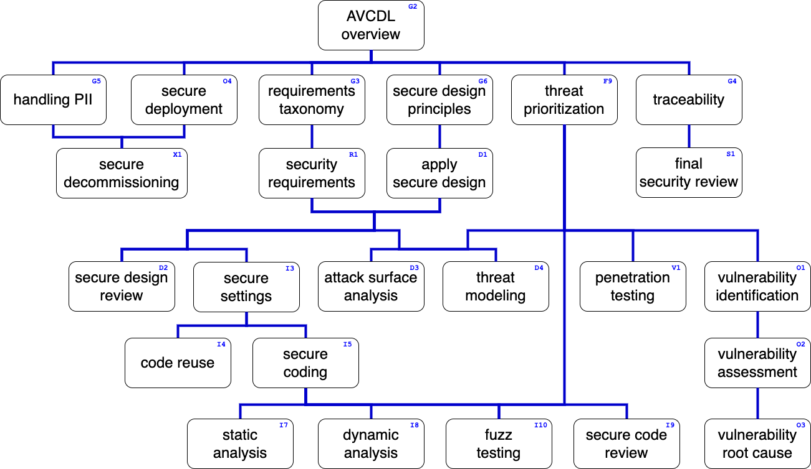
Training Path
Notes:
Script:
This diagram shows the overall AVCDL training path.
If you're taking this training, it's assumed that you've already completed the AVCDL overview training.
This training will cover Secure Design Principles.

Slide 3
Introduction
Notes:
Script:
Unlike just about every other aspect of the AVCDL, secure design principles isn't about a specific activity and a specific outcome with specific metrics.
It's about a way of looking at how we treat the system and how we approach design from the standpoint of cybersecurity with an understanding that fundamentally cybersecurity engineering is about the soundness of the code and the system supporting the code.
We're going to look at a set of principles which, when applied, lead to a system which is much more conducive to having the cybersecurity processes and activities called out within the context of the AVCDL applied to that system, and which is fundamentally more secure because is has had these fundamental aspects put in place during its design.

Slide 4
Principles
Modularize
Minimize surface area
Isolate security
Isolate privilege
Use least privilege
Use hierarchical trust
Limit lifetimes
Use standards-based cryptography
Use adaptive cryptography
Use trusted communication channels
Enable auditing
Degrade as necessary
Notes:
Script:
Now we talk about design principles here and not design rules.
We're not going to have these completely orthogonal, well-defined, SMART-compliant INCOSE-esque rules.
What we're going to have is principles, where a principle is a fundamental proposition that serves as a foundation for a system or behavior.
And the behavior that we wish to ensure is that the system is secure within the context of cybersecurity.
This short list that we have for our principles is going to be presented in a relatively hierarchical fashion.
The ones that come first are built upon by the ones that come later.
The list that we have is:
Modularize
Minimize surface area
Isolate security
Isolate privilege
Use least privilege
Use hierarchical trust
Limit lifetimes
Use standards-based cryptography
Use adaptive cryptography
Use trusted communications channels
Enable auditing
and
Degrade as necessary
Now let’s look at each of these in more detail.

Slide 5
Modularize
Notes:
Script:
The first principle is perhaps the most obvious and the most overlooked, and that would be to modularize.
It's well appreciated that monolithic designs are Intrinsically difficult to analyze, build, debug, test, and also, by extension, defend.
This is especially true in a cybersecurity context.
And so, when we talk about modularization, it's nothing new.
Let's just look at modularization within the context of cybersecurity.
Instead of just looking at function as the basis for modularization, we'll consider things like trust, privilege, and policy.
Let's look at some of the areas where we consider modularization traditionally and how they translate.

Slide 6
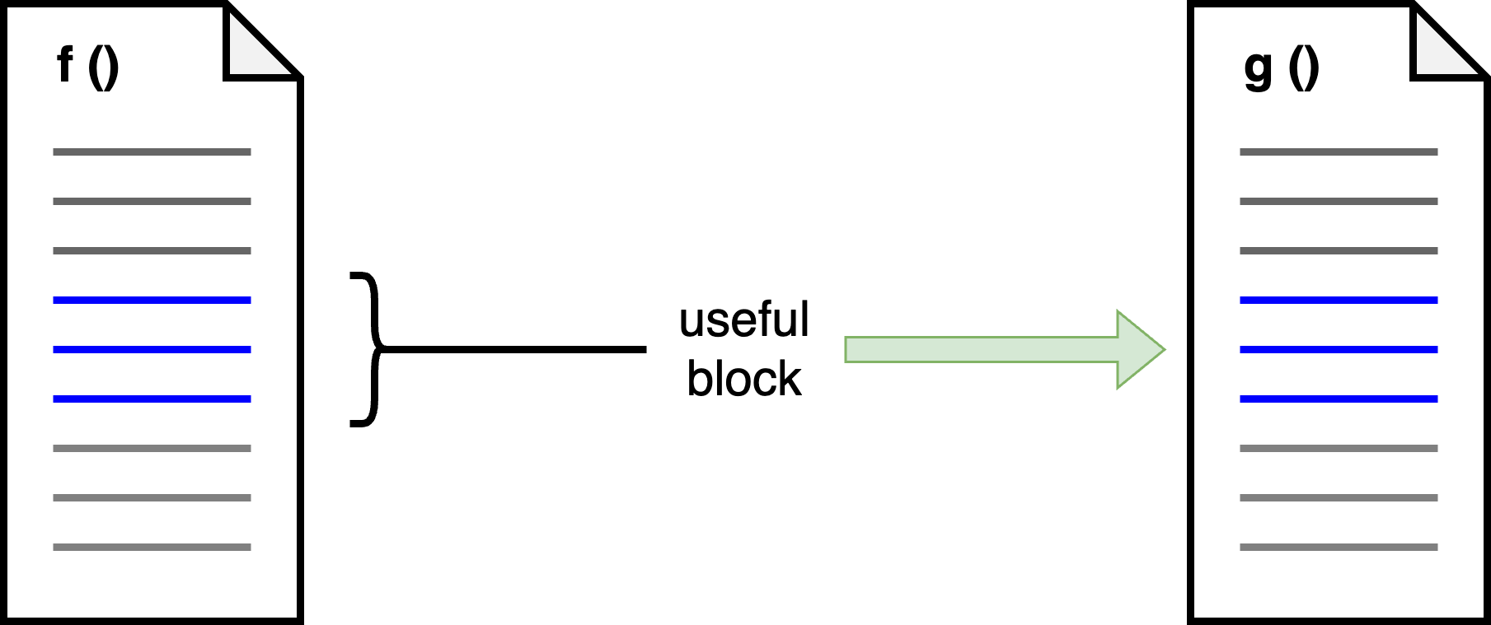
Refactoring
Notes:
Script:
Let's start with our first area of modularization.
And that's refactoring.
So here we have function F.
And during our development, we decide that that there's this useful piece.
We decide that we could use it in our other function over here, G.
So, we simply copy-and-paste that useful block into function G.
Over time, this isn’t a really great approach because If the block in question is of a sufficient level of complexity, changes to it in the future become problematic to manage.
So, what we typically do is switch to an extraction approach.
[break]
And just make it its own function and call it that way.
The same thing is true for cybersecurity.
Cybersecurity, especially in the realm of cryptography tends to be one of those things that people look at the same way that they look at opening files.
I'm going to open a file now.
I'm going to do stuff to the file.
And eventually, I'll close the file.
For convenience's sake, let's just open it at the beginning of function and close it at the end of the function.
Or worse, at the beginning of the process, we will acquire our cryptographic bits and put them into the global state, and then we won't have to worry about them.
We'll just pick at them as we go.
Now, neither the file example nor the cryptographic one are modular in any sense.
What you have is this shared state, which is hard to manage, and something that you really could stand to extract, if simply for the purposes of being able to test it.

Slide 7
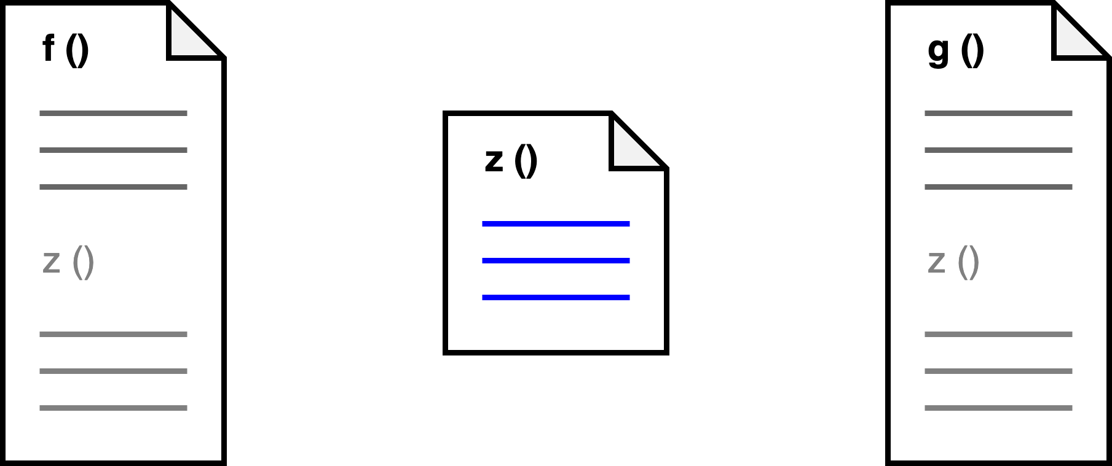
Refactoring
Notes:
Script:
Let's start with our first area of modularization.
And that's refactoring.
So here we have function F.
And during our development, we decide that that there's this useful piece.
We decide that we could use it in our other function over here, G.
So, we simply copy-and-paste that useful block into function G.
Over time, this isn’t a really great approach because If the block in question is of a sufficient level of complexity, changes to it in the future become problematic to manage.
So, what we typically do is switch to an extraction approach.
[break]
And just make it its own function and call it that way.
The same thing is true for cybersecurity.
Cybersecurity, especially in the realm of cryptography tends to be one of those things that people look at the same way that they look at opening files.
I'm going to open a file now.
I'm going to do stuff to the file.
And eventually, I'll close the file.
For convenience's sake, let's just open it at the beginning of function and close it at the end of the function.
Or worse, at the beginning of the process, we will acquire our cryptographic bits and put them into the global state, and then we won't have to worry about them.
We'll just pick at them as we go.
Now, neither the file example nor the cryptographic one are modular in any sense.
What you have is this shared state, which is hard to manage, and something that you really could stand to extract, if simply for the purposes of being able to test it.

Slide 8
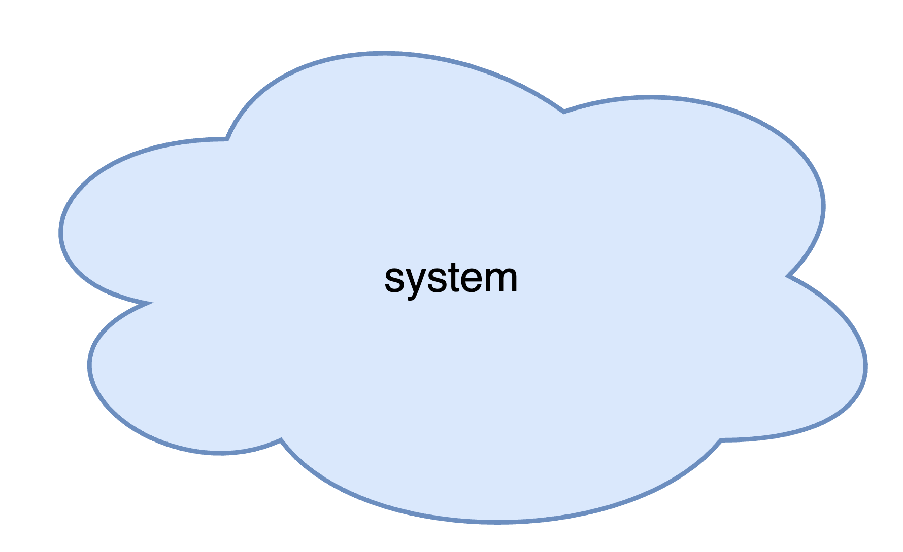
Decomposition
Notes:
Script:
At a larger scale, this is all about decomposition.
Our system should not just be this amorphous blob that we can only reason on in the context of cybersecurity by using things like penetration testing, which is simply blind QA.
It may be perfectly attuned to a non-decomposed system, but that doesn't help us from a design standpoint.
What we want is a decomposed system that helps us in the context of cybersecurity.
[break]
That means that we're going to look at things like the operating system broken down into its processes, things like the
• file system
• process manager
and
• network manager
We're going to think about the resources that we're trying to utilize.
Resources may be hardware, so direct hardware manipulation, or they may be data.
Do we have third-party components in use?
Here, we're talking about things like data and audit log managers.
And finally, we're going to look at the components that we're bringing along to the party.
These are our
• processes
• services
and
• drivers

Slide 9
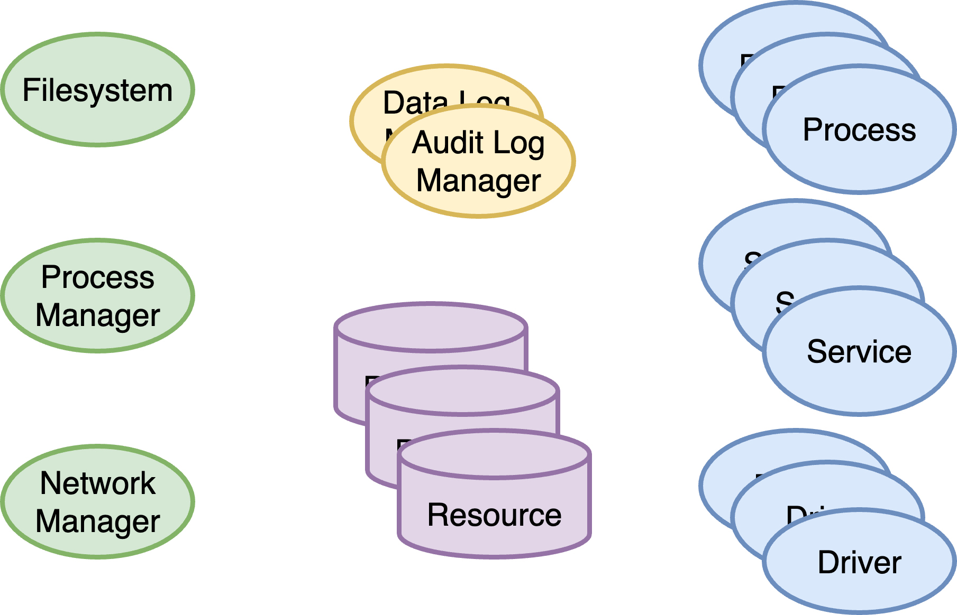
Decomposition
Notes:
Script:
At a larger scale, this is all about decomposition.
Our system should not just be this amorphous blob that we can only reason on in the context of cybersecurity by using things like penetration testing, which is simply blind QA.
It may be perfectly attuned to a non-decomposed system, but that doesn't help us from a design standpoint.
What we want is a decomposed system that helps us in the context of cybersecurity.
[break]
That means that we're going to look at things like the operating system broken down into its processes, things like the
• file system
• process manager
and
• network manager
We're going to think about the resources that we're trying to utilize.
Resources may be hardware, so direct hardware manipulation, or they may be data.
Do we have third-party components in use?
Here, we're talking about things like data and audit log managers.
And finally, we're going to look at the components that we're bringing along to the party.
These are our
• processes
• services
and
• drivers

Slide 10
Minimize Surface Area
Notes:
Script:
Our next principle is to minimize the surface area.
And by surface area we're talking not about just the physicality of the system but also constructs that are within it.
So, let's look at that.

Slide 11
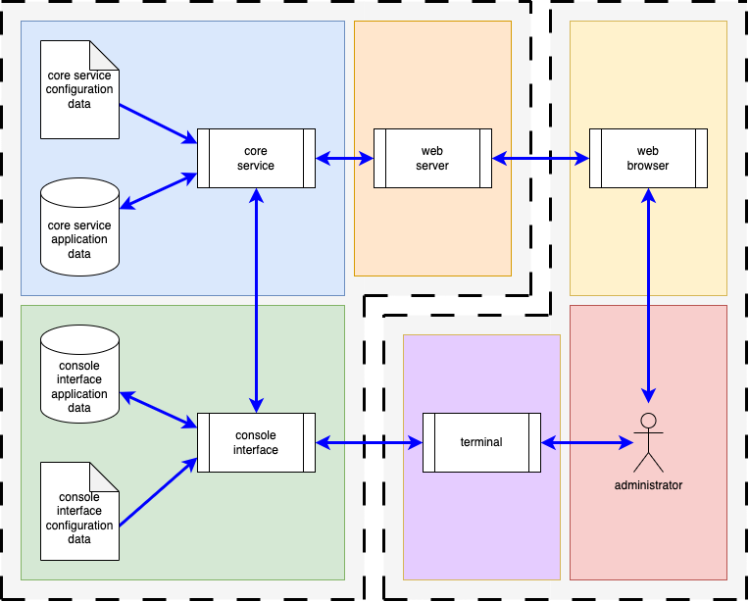
Surface Area
Ports
Protocols
Processes
Notes:
Script:
Here's a simple system that is used within the AVCDL as a basis for explaining various concepts.
In the context of surface area, we're going to think about three different things.
One is the ports that we have.
These are the physical holes in the box, if you will.
The next are the protocols that run over the communications that traverses those holes in the box.
And finally, we have the processes that are handling the data that's typically traversing the communications protocols and the holes in the box.
There are some interesting things to tease out with this diagram.
As you can see, the system here is neatly decomposed.
Stuff on the left is inside of the element that we're concerned with.
The stuff on the right is the system that is interacting with it.
So, we have from this diagram a basis for discussion.
The fact that we've chosen the ports, the protocols, and the processes is not arbitrary.
These are things that we can look at and we can reason on in a very straightforward manner.
They are a very light touch.
Essentially what we're talking about is control points that allow us access to the system.
What we're trying to do is keep them to the absolute minimum, because there's no point in having more gates into your castle than you can guard.

Slide 12
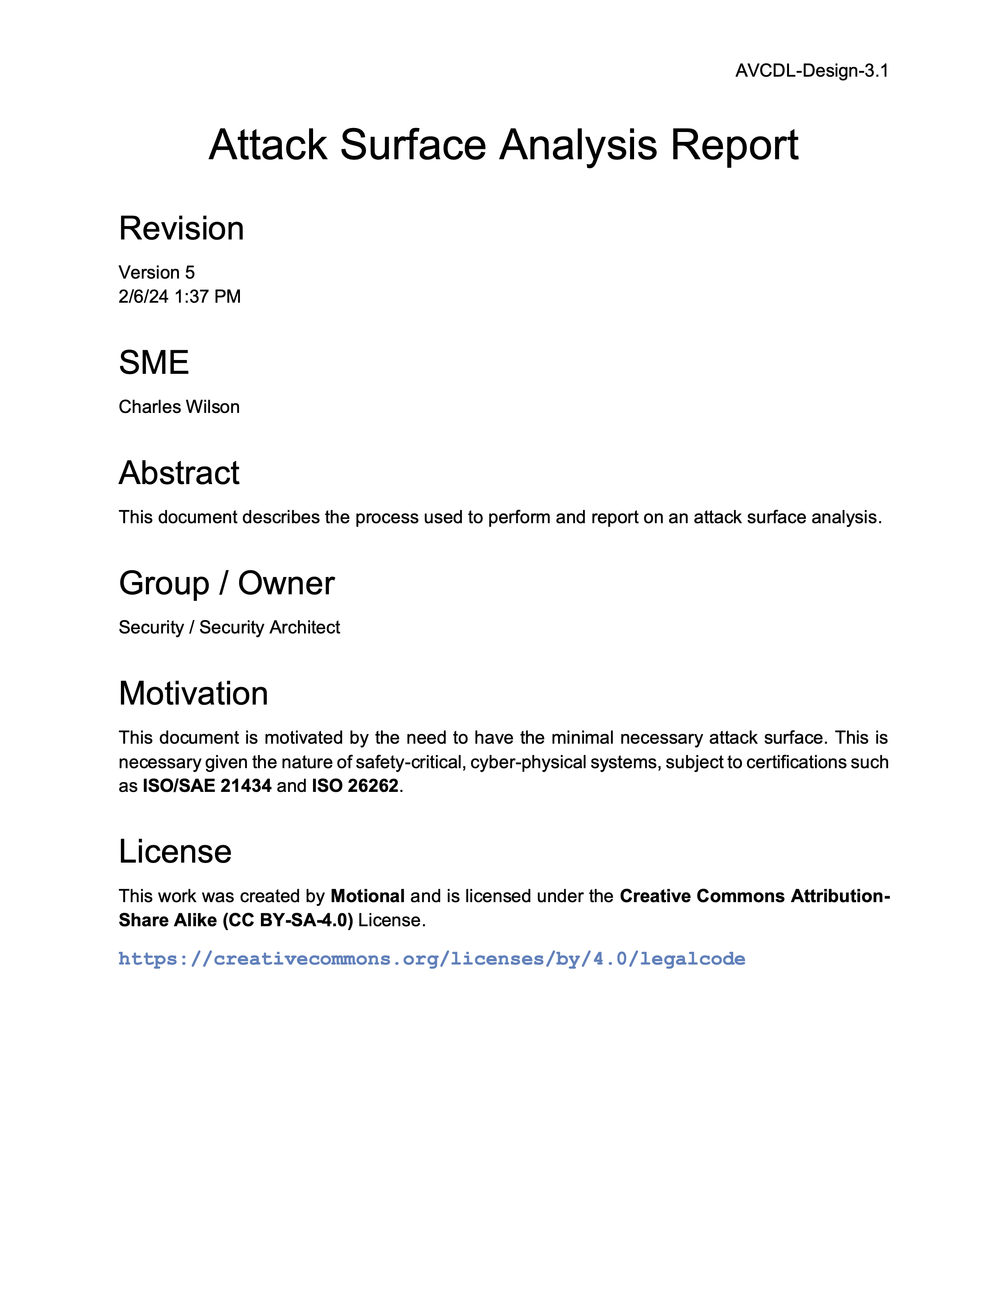
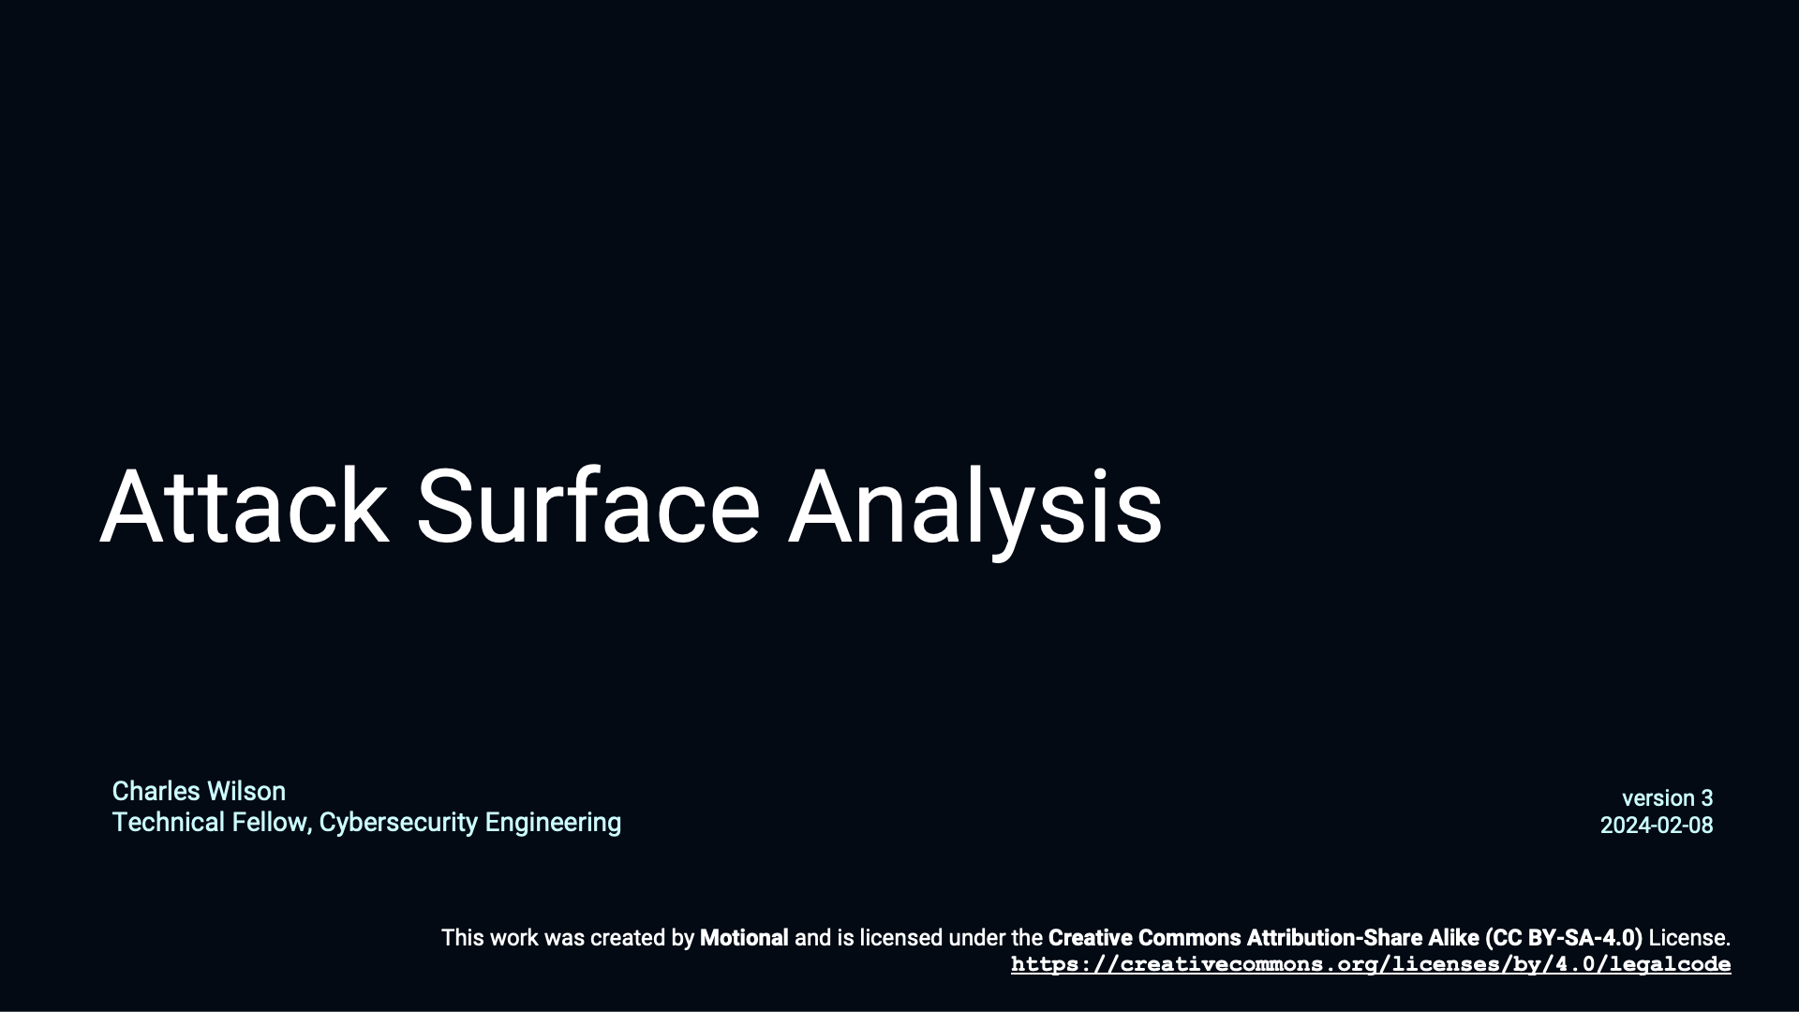
More Info
Notes:
Script:
I'm not going to go into any more depth on this point because it's specifically addressed in detail in the Attack Surface Analysis material that we have both in document form and in a training by the same name.

Slide 13
Isolate Security
Notes:
Script:
Our next principle combines the concepts of modularization and surface area minimization.
We’ll now address an application of these in the form of isolation of security.

Slide 14
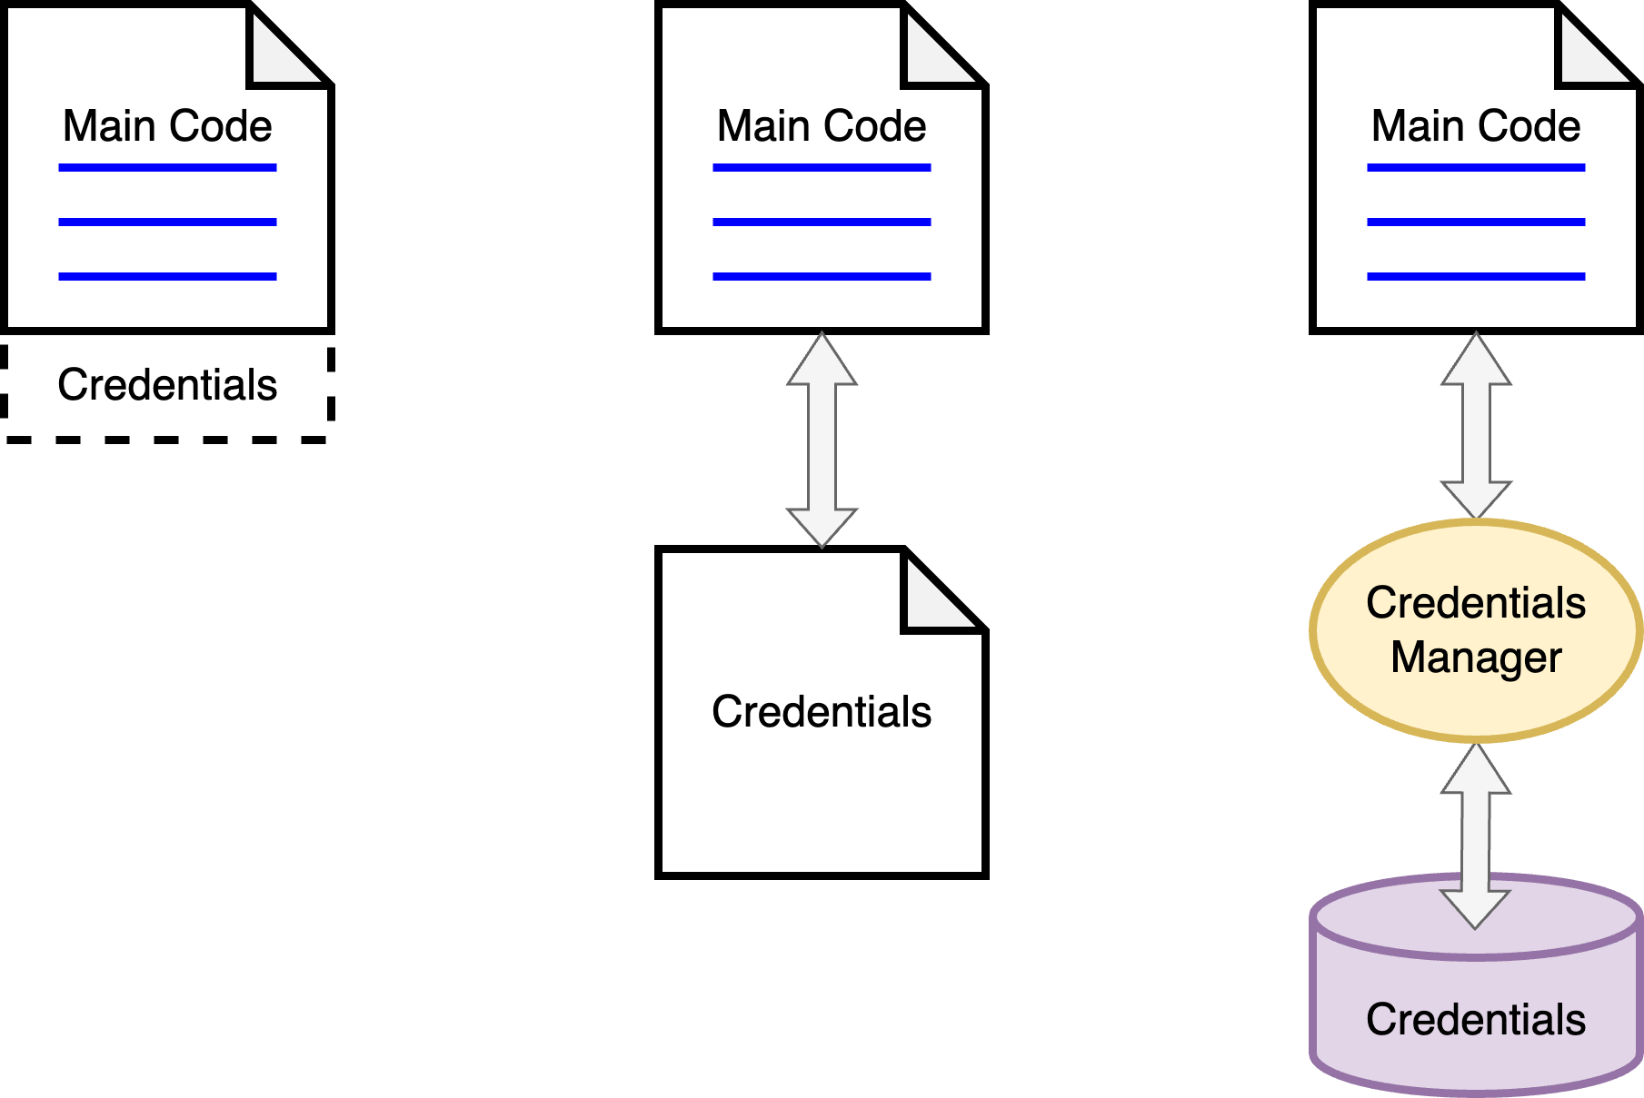
Isolate Security Data
Notes:
Script:
Security isolation is going to come in two flavors, the first of which is data security isolation.
When we start out with things, we tend to have this structure where we have code, and we have our credentials, our cryptographic key, whatever, embedded within the code itself.
Our first step in isolation is to take those credentials and move them into a separate file accessed from the code.
Better, but not great, because, well, what if we need to change them?
What if there's a different process that needs to access them?
For our third stage, what we have is the code talking to a credentials manager, which handles the credentials. Here we show them as a database.

Slide 15
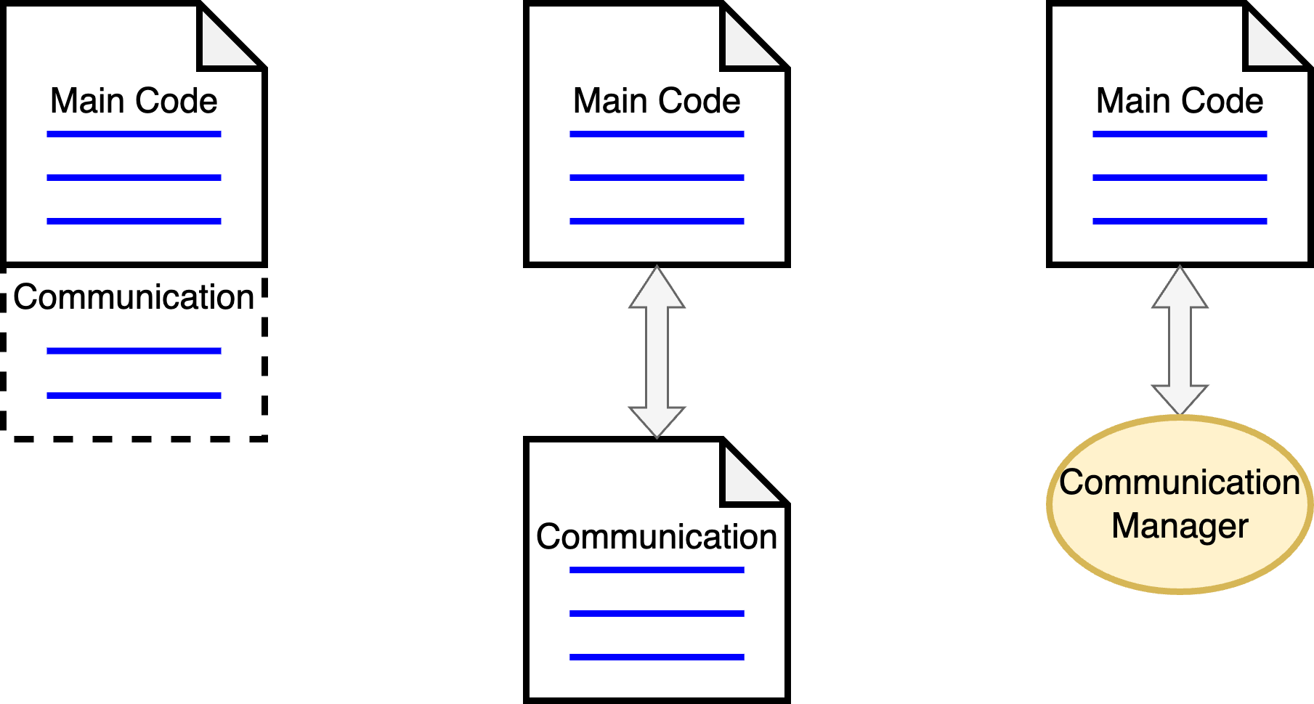
Isolate Security Processes
Notes:
Script:
Likewise, as an extension of our modularization discussion, we have communications code that's embedded in the main code.
This again is treating our secure communications as sort of the file system and we just sort of open it, we play with it, and stuff goes on.
Our next approach is to take that and again split it into its own file.
Our final extension of this is to take that communications code and make a communications manager out of it, which pairs nicely with our handling of secure data.

Slide 16
Isolate Privilege
Notes:
Script:
Now let's consider a peer to isolating security, and that's going to be isolating privilege.

Slide 17
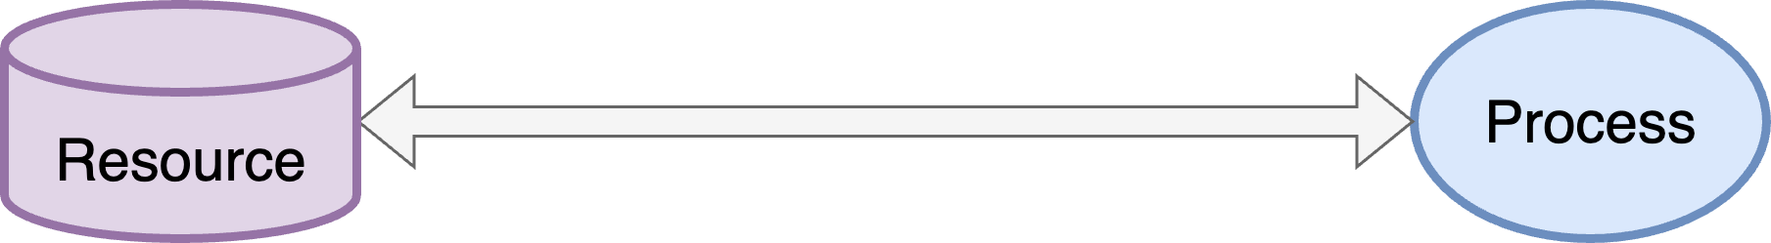
Isolate Privilege
Notes:
Script:
We’ll start with our simplest case.
We have a process and it's going to be accessing a resource directly.
Now, if it's the only process accessing this resource, then there really is no problem.
It has to access it, can do so, and so we don't worry too much about it.
But we typically don't have situations this trivial.

Slide 18
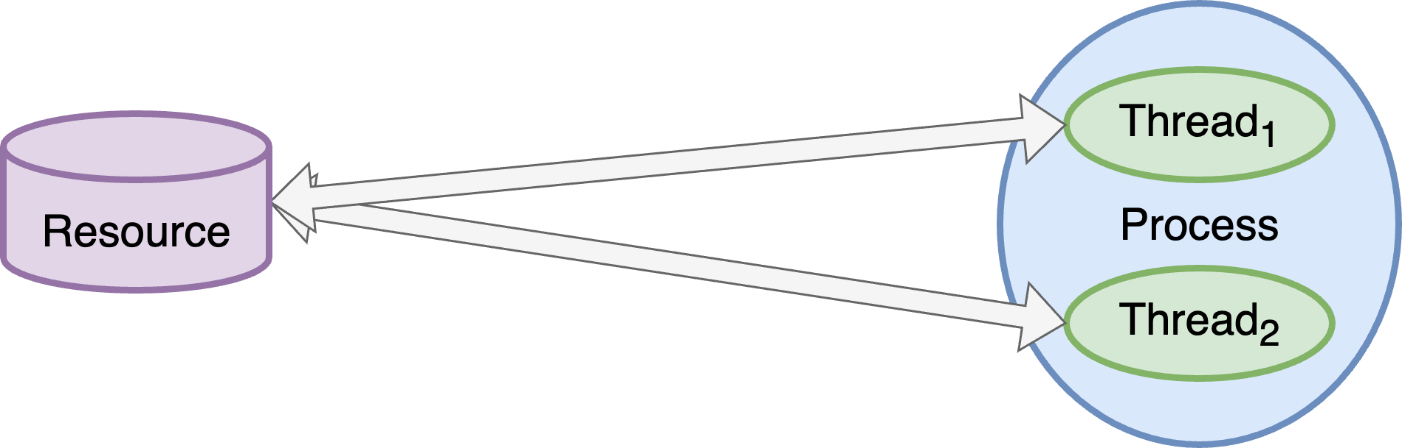
Isolate Privilege
Notes:
Script:
In a more sophisticated scenario, we have multiple threads running within the process, and as you can see here, both threads are accessing our resource.
Since the process has the privilege to access that resource, any thread within that process will also have the privilege to access the resource.
Ignoring the fact that we now have a situation where there’s a risk of a race condition at some point in the future, we have the problem where we now question whether or not the privilege is isolated.
If we have multiple threads accessing the same resource, we should be asking ourselves:
Do all threads need to access this resource?
and
How will we keep arbitrary threads within our process from being able to access the resource?

Slide 19
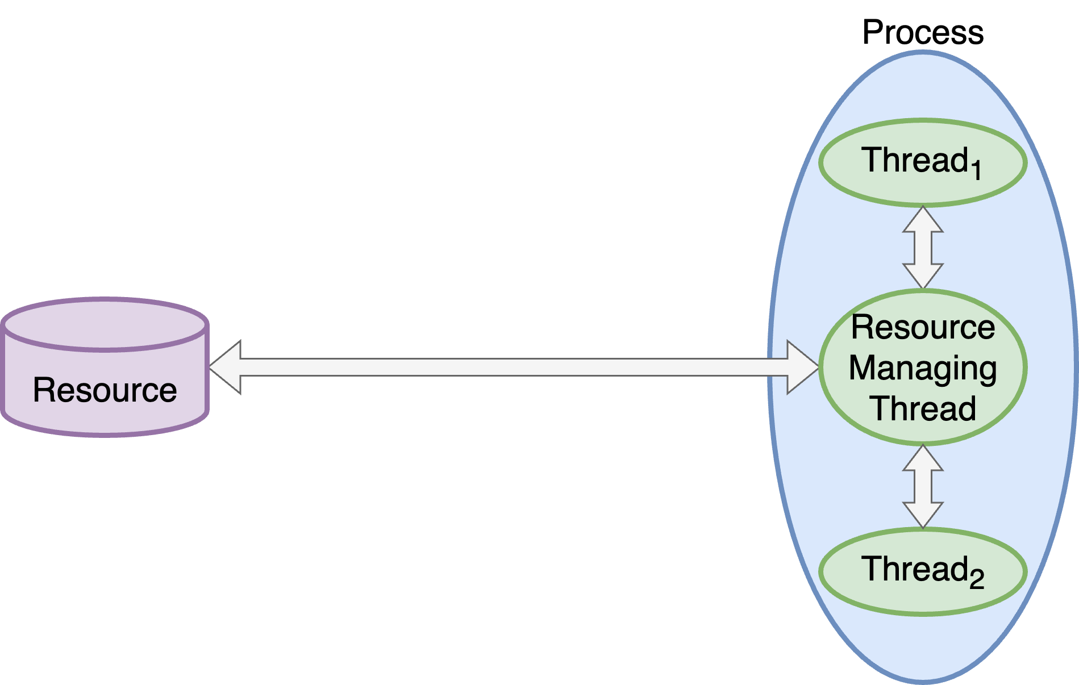
Isolate Privilege
Notes:
Script:
One way to address this situation is ironically by introducing another thread.
We give this thread direct control over the resource.
This doesn't keep the other two threads from accessing that resource, but it makes it less likely that this will happen because we can take certain steps to access that resource exclusively.
We still haven't gotten rid of the problem that we're trying to address, which is to isolate the privilege.
We've basically just isolated the security.
The privilege is still associated with every thread in this process.

Slide 20
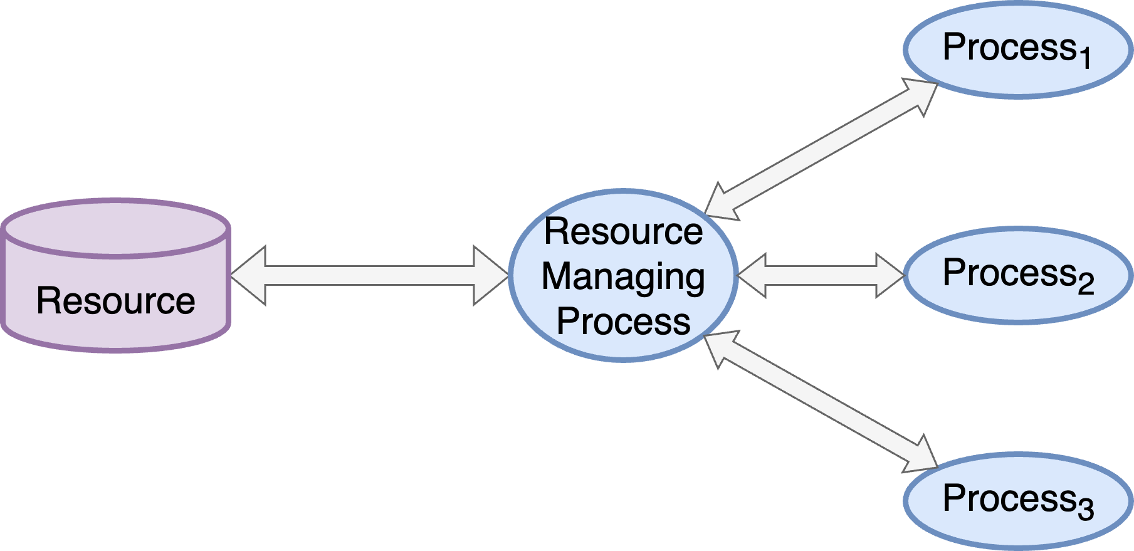
Isolate Privilege
Notes:
Script:
In order to completely isolate privilege we need to move control of the resource to its own process.
This approach meshes well with the isolate security aspect.
It also goes along with a recommendation that a resource should be controlled by a single process.
This greatly simplifies control and makes it much simpler to test and mock the resource, and it deals with the case where multiple processes need to access the resource.

Slide 21
Use Least Privilege
Notes:
Script:
This brings us to our next principle, that being use least privilege.

Slide 22
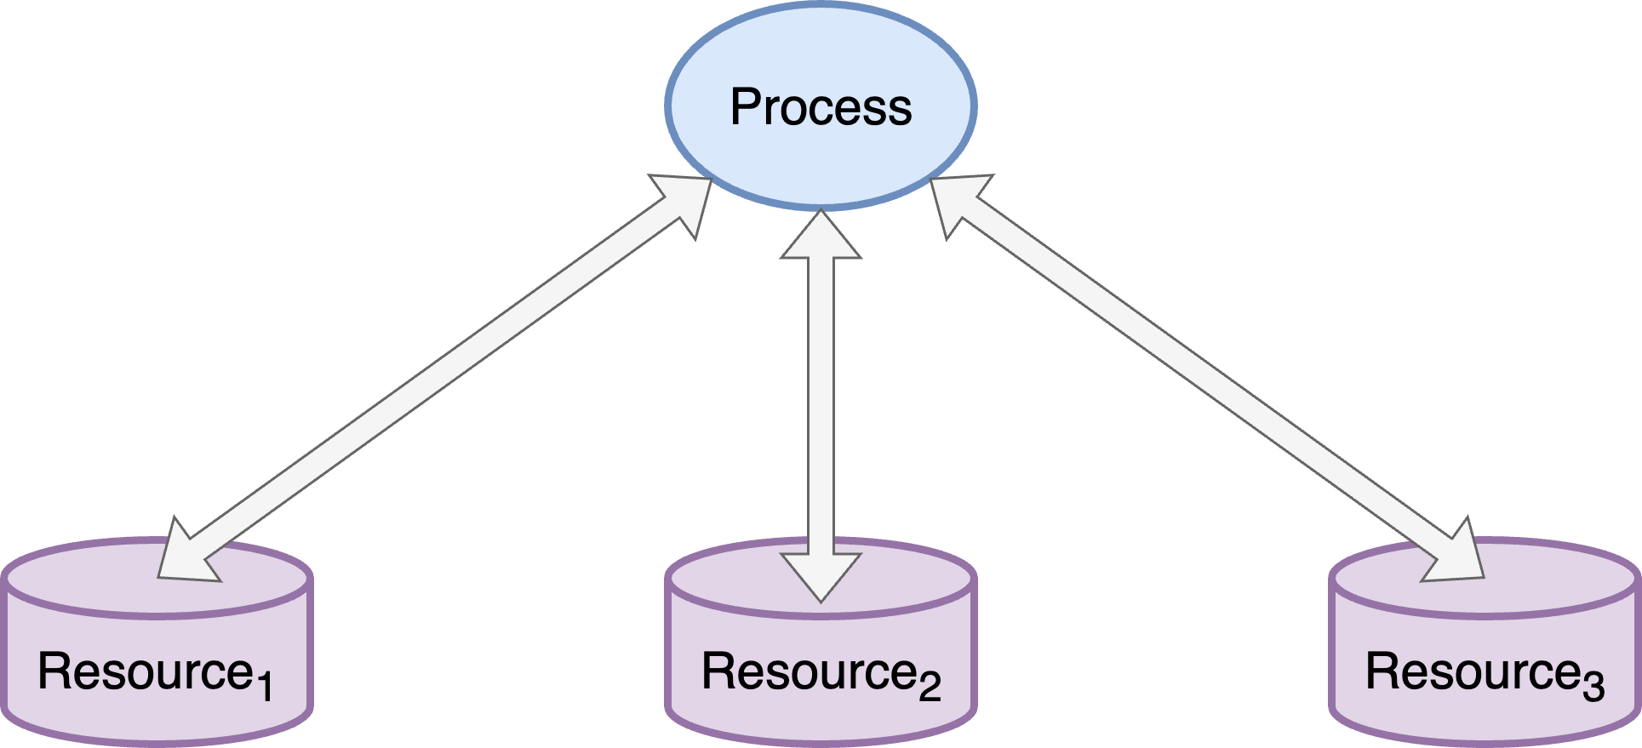
Use Least Privilege
Notes:
Script:
Extending the concept of isolated security and isolated privilege, with least privilege we’re taking a situation such as this, where we have a process accessing multiple resources.
We don't know compositionally what's happening inside the process, but it's doing these discrete resource manipulation activities.
In the generic case these resources require different sets of privilege.
And so, to have a single process which has these three sets of privilege is not ideal.
There've been a lot of security issues that have come up over the years because a process has too much privilege.
These type of constructs are leveraged to do things they otherwise shouldn't do.
[break]
To address this, we echo of our previous guidance and employ complete mediation of each resource by adding dedicated resource managers.
This limits the privilege required to the context of resource’s manager.
If you have a process which needs to access a resource, it should be going through the process which is the resource owner.
If you have a process which doesn't need to manipulate a resource, then the question becomes, is it necessary to access that resource at all?

Slide 23
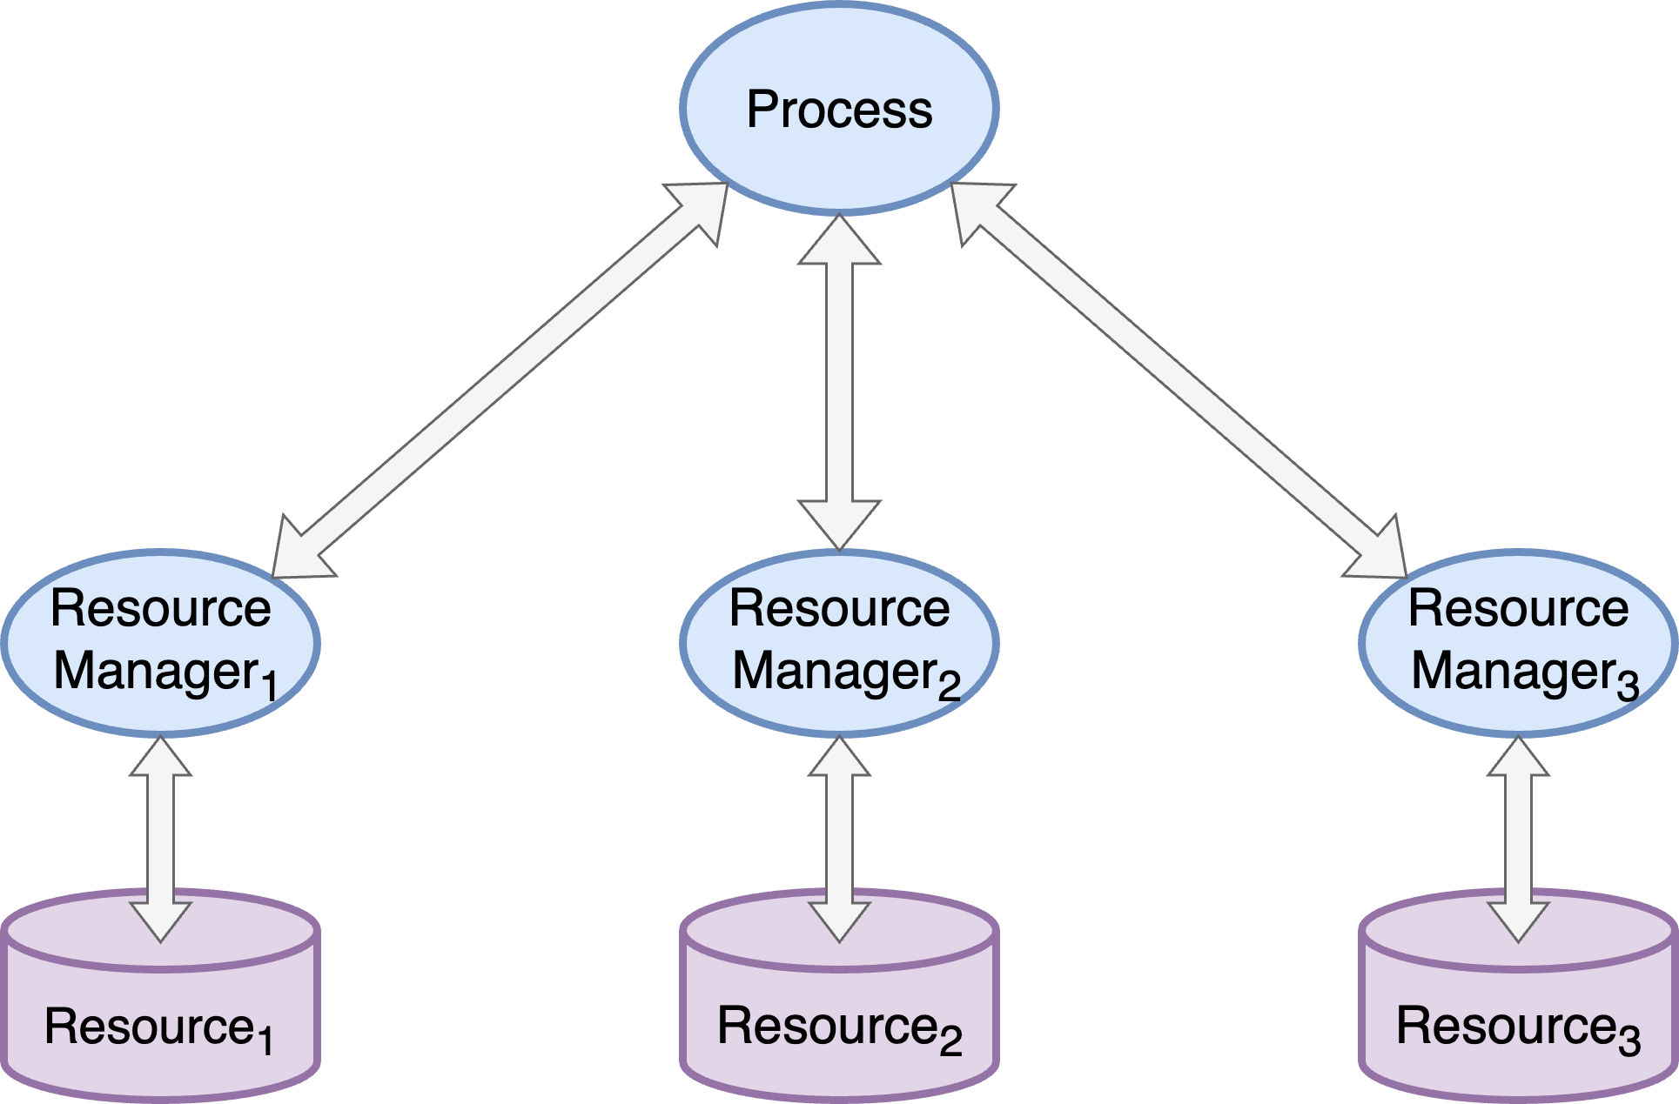
Use Least Privilege
Notes:
Script:
Extending the concept of isolated security and isolated privilege, with least privilege we’re taking a situation such as this, where we have a process accessing multiple resources.
We don't know compositionally what's happening inside the process, but it's doing these discrete resource manipulation activities.
In the generic case these resources require different sets of privilege.
And so, to have a single process which has these three sets of privilege is not ideal.
There've been a lot of security issues that have come up over the years because a process has too much privilege.
These type of constructs are leveraged to do things they otherwise shouldn't do.
[break]
To address this, we echo of our previous guidance and employ complete mediation of each resource by adding dedicated resource managers.
This limits the privilege required to the context of resource’s manager.
If you have a process which needs to access a resource, it should be going through the process which is the resource owner.
If you have a process which doesn't need to manipulate a resource, then the question becomes, is it necessary to access that resource at all?

Slide 24
Use Hierarchical Trust
Notes:
Script:
With our next principle, we're going to shift gears a little bit and talk about trust, specifically hierarchical trust.
So, let's get into what trust is and how it becomes hierarchical.

Slide 25
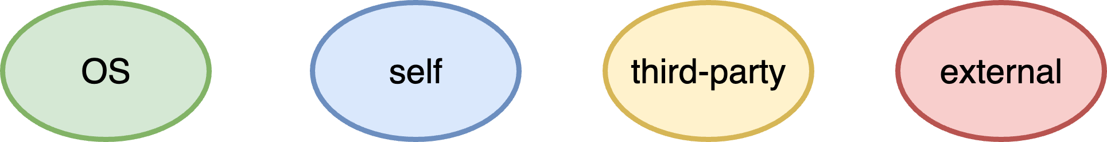
Trust Levels
Notes:
Script:
When we talk about trust, we're going to consider four broad categories.
The first is naturally self. Here shown in blue.
Anything that we create, or control directly has our implicit trust.
The elephant in the room here is that we don't create everything.
Because of that, there are things which we're not going to trust at all by their very nature, and there are things that we're going to have to trust to function from a cybersecurity perspective.
The thing that we're going to have to trust is the operating environment that we're based on.
If you're using a system that has access control lists, distinct ownership of processes, control of resources, memory, things of that nature within the context of the operating environment, unless you directly certify it yourself, you're putting trust in it.
You shouldn’t trust the operating system blindly.
It's important where the operating system comes from, and how it's configured.
But fundamentally, we're going to trust the operating system and so we'll show it in green.
There's a lot we depend on that isn't the operating system.
If you use a compiler, you’re using its libraries.
There are open-source and third-party materials we use to augment what we create ourselves.
These do not have the same level of trust we give our own materials, and it certainly doesn't have the same level of trust that we give to the operating system.
So, we'll put these in its own bucket labeled third-party, shown in yellow.
It’s incumbent upon us to make sure that we give this material an appropriate level of scrutiny before using it.
Finally, there's the outside world, external stuff.
Uniformly, we're going to treat anything that's external to our system as being hostile, because it is completely outside of our control.
Now you might say “well, I have this data center that I talked to,” or “I have this other device that I'm interacting with,” and to that I say that you need to take steps to ensure that when interacting external entities, you know who you're talking to, and apply a consistent level of controls to the communication channel.
And this is most readily done by treating all external entities as untrusted, here shown in red.

Slide 26
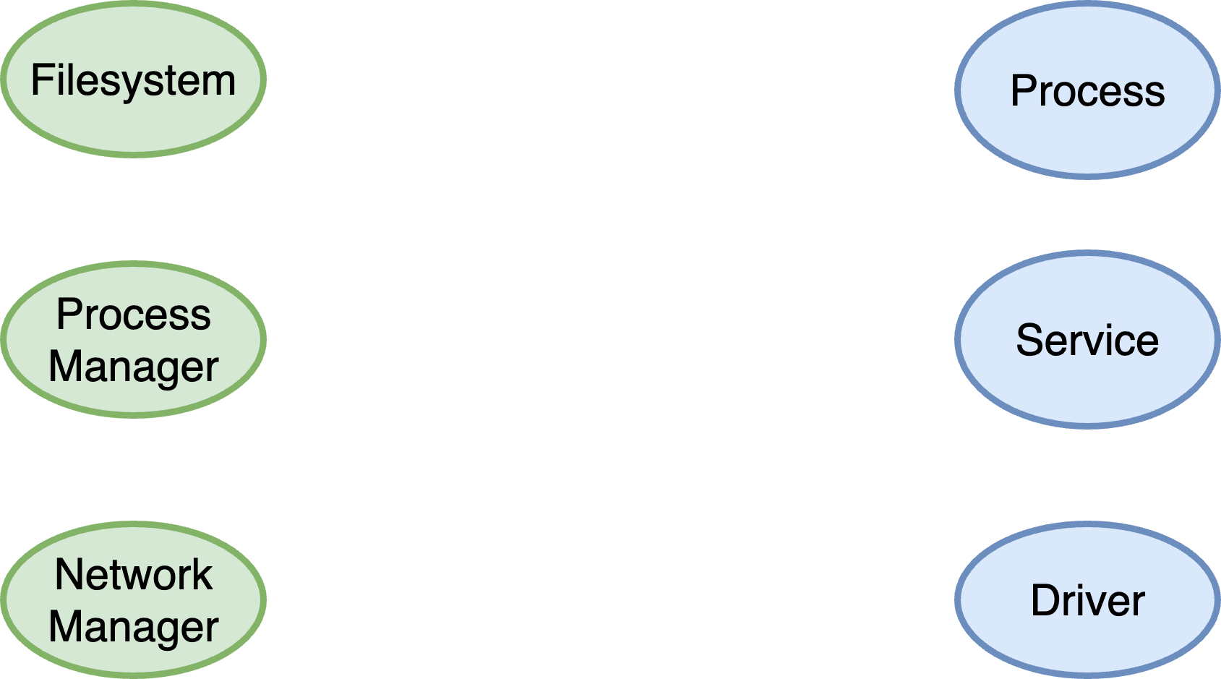
Entities
Notes:
Script:
Now, let's consider some entities.
For the operating system, there are three main entities we care about the
file system
process manager
And
network manager
There are others, but fundamentally these are the ones we work with most often.
On the user side, we talk about
Processes - so standalone things
Services - highly structured and contextualized processes that work within a service manager
and
drivers - dedicated elements that do the work of connecting real world bits to the operating system such that they can then provide those bits up to the services and processes

Slide 27
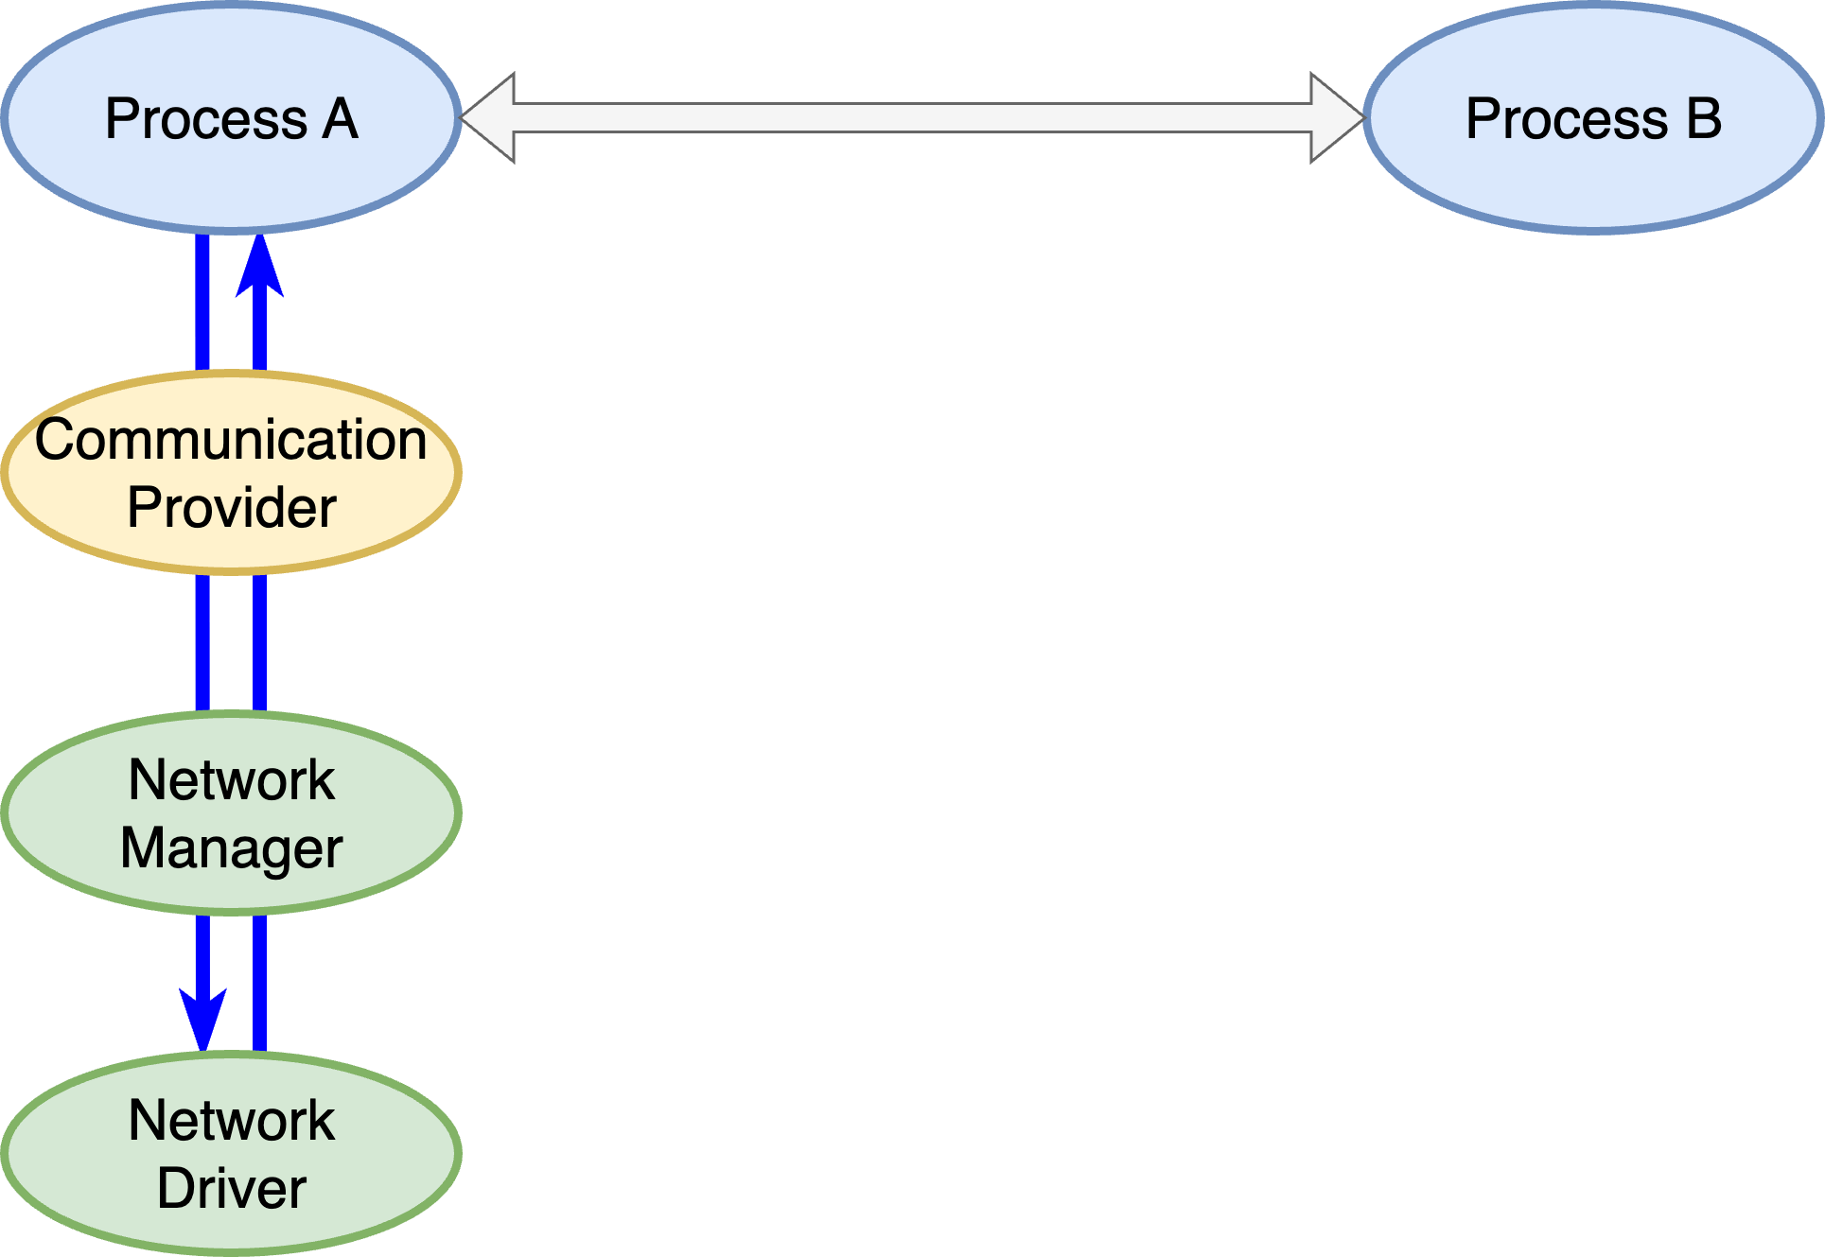
Trust Traversal
Notes:
Script:
So, we have these trust levels, and we’ve established some interesting entities.
Let’s consider what we mean by hierarchical trust.
If we take the simple case where process A wants to communicate with process B.
Process A uses a communication provider, and that communication provider is a third-party component.
So, what does it mean for us?
We know that the communication provider is something we need to pay attention to, but we also know it will be talking to the network manager.
And the network manager is a trusted component.
That's great.
Additionally, the network driver is also provided by the operating system, and so that's trusted.
What we’re doing here is building up a level of confidence in how we undertake our operations.
Keep in mind that this approach can be applied any set of operations.

Slide 28
Trust Levels Visualized
Notes:
Script:
Now, let's look at a more elaborate example.
Going back to the example system that we talked about earlier when we were considering surface area minimization.
Here’s its fully expressed data flow diagram, color-coded with trust levels.
As you can see, it's not purely hierarchical.
We don't go from the operating system through our own code, through third-party components to the outside world.
We have a partially-ordered hierarchy, but fundamentally we have established the system in such a way that aids us when we're thinking about where to put cybersecurity controls.
If we look at something like the core service talking through the web server and eventually to the web browser; what we see is that there is mediation being done by operating system components that we do trust.
Also, since the web server is a third-party component, we will need to pay greater attention to it.
When it comes to external entities, don’t give them any trust.
Everything external is requires far more control from a cybersecurity standpoint.
Overall, what we're attempting to establish, when considering trust within the system, is what entities we’re dealing with.
That information will feed into downstream cybersecurity processes.

Slide 29
Limit Lifetimes
Notes:
Script:
Our next design principle is that of lifetime limitation.

Slide 30
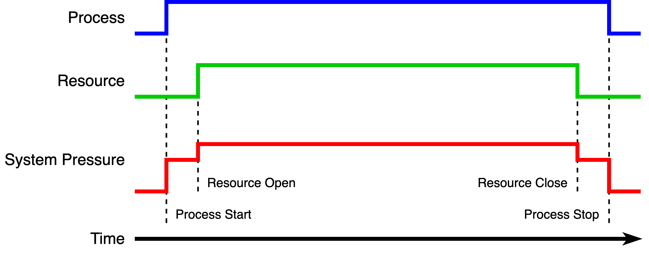
Resource Analog
Notes:
Script:
Let's consider a relatable scenario.
We have a process.
We have a resource.
We're going to consider the pressure that that puts on the system.
And we're going to do it over a period of time.
At some point, our process starts and that creates a certain amount of pressure on the system.
A bit later we open our resource which has an incremental impact on the system pressure.
We go along in time.
And at some point, we close that resource, lowering the system pressure.
Finally, at some later point, we stop the process, which drops the system pressure back down.
If we have a finite resource, that being the capabilities of the system, and we exert a particular pressure on it, at a certain point it reaches its limit and can no longer function in the way that we'd like.
So, we limit the individual impact of each of our processes and the usage of various resources.
You'll notice that the highest pressure exists within this window between when the resource is open and when the resource is closed.
Everyone can relate to this example.
Now, If we think about this from a cybersecurity perspective.
The process is the same.
The resource might be a credential we’re working with and is therefore out in the open.
We're doing this over a particular period rather than thinking about system pressure.
In the context of an attack surface, this represents a window of opportunity during which an attacker could possibly gain access to that resource.
By limiting the lifetime, we reduce that window of opportunity.
That's what we are thinking about from the cybersecurity perspective.
Turning it around.
The less time that you're using a resource, the less pressure it exerts.
The less time that you're using a resource, the fewer variables are in play.
Therefore, it makes it easier to debug.
So, limiting lifetimes has advantages beyond simply the amount of pressure it's putting on a system or the window of opportunity that it's providing for attack.

Slide 31
Use Standards-based Cryptography
Notes:
Script:
Our next principle is to use standards-based cryptography.
Regardless of how much math you studied in school or how many open-source projects you've worked on, there is no reason in this day and age to go about creating your own set of cryptographic methods.
The number of times that bad cryptography has come out of well-intended individuals is well documented.

Slide 32
Consult Your Product Cybersecurity SME
Notes:
Script:
It's great to say use standards-based cryptography, but which standard do you use when there are so many to choose from?
This is a domain-specific issue.
It may also be to be constrained by your supply chain.
The best way to handle these cases is to consult with your product cybersecurity SME because they will be up-to-date on what the appropriate algorithms, use cases, and key strengths are going to be for the specific domain and use case in question.

Slide 33
Use Adaptive Cryptography
Notes:
Script:
Unfortunately, it's not enough to just use standards-based cryptography.
Our next principle is that we should use adaptive cryptography.
As time progresses, even the best cryptographic suite will become susceptible to compromise as computing power increases.
This means that the elements of cryptography, that is the cryptographic function, it's use case, and its key strength, all need to change over time in order to maintain the same level of security.
So, let’s consider what this entails.

Slide 34
Crypto Agility
Protocols
Applications
Software
Hardware
Infrastructure
Notes:
Script:
When NIST talks about the adaptive cryptographic approach, they use the term crypto agility.
This they describe as the capabilities needed to replace and adapt cryptographic algorithms without interrupting the flow of a running system in order to achieve resiliency.
What kind of things are we talking about?
Where could this possibly impact us?
NIST provides a list that includes the:
Protocols
Applications
software
hardware
and finally
infrastructure

Slide 35
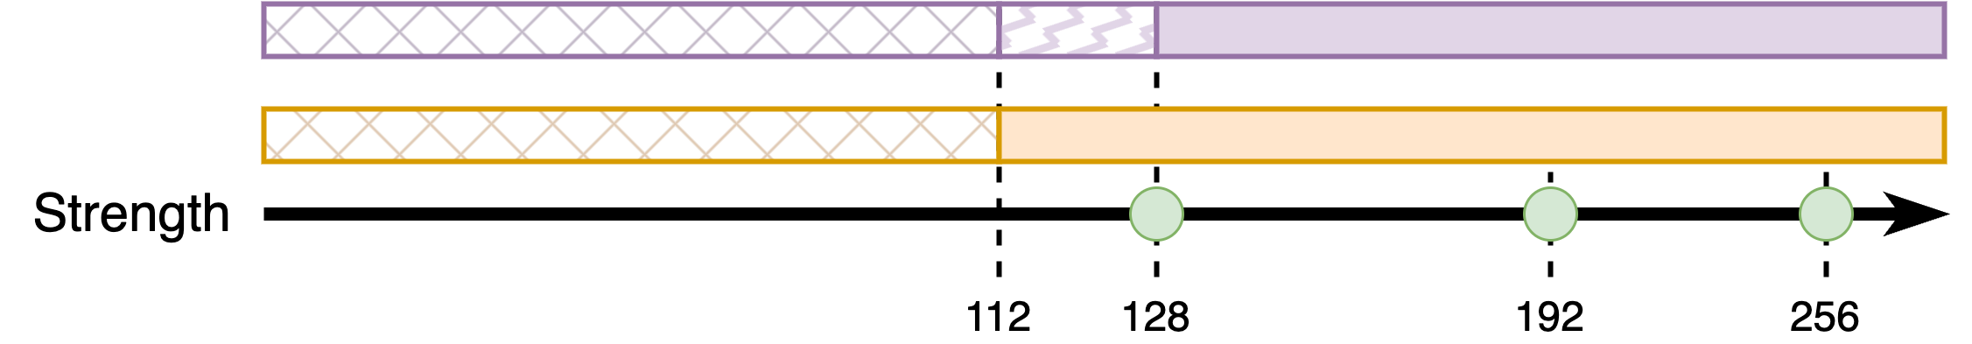
Cryptographic Variables
Algorithm
Cryptographic primitive
Key strength
Hashing
Encryption
Authentication
Key exchange
SHA
TDEA
AES
KMAC
Notes:
Script:
When we get to the specifics of what is changing within the context of cryptography, then we have three main variables.
First, there's the algorithm.
This is the use case.
It can be hashing, encryption, authentication, or key exchange.
Second, there’s the cryptographic primitive.
This is the math underlying the operation.
These include SHA, TDEA, also known as Triple-DES, AES, and KMAC.
Finally, is the key strength.
Over time we need to increase the key size for a given algorithm to have the same strength for the current state of hardware.

Slide 36
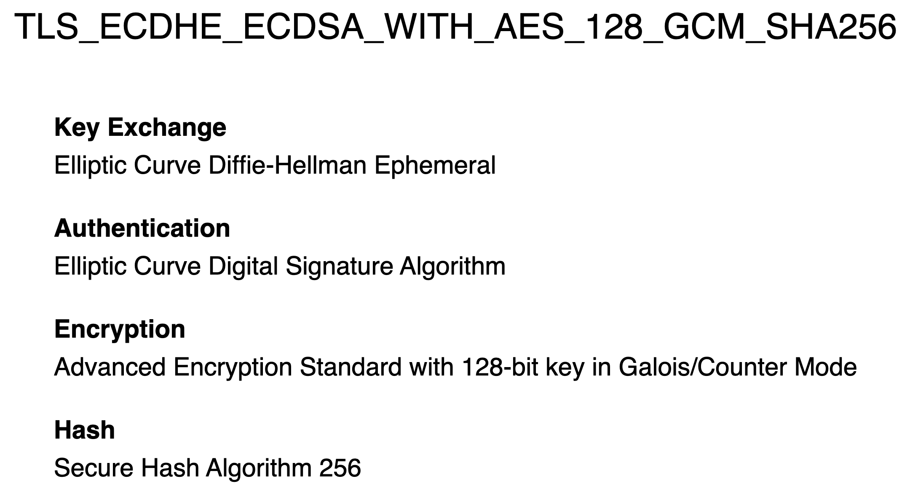
Transport Layer Security
Notes:
Script:
Now let's consider a real-world example of crypto agility done right.
For that, we're going to use the transport layer security, also known as TLS as our example.
When TLS is used, one of the first things that happens is a negotiation phase at which time a list of crypto suites is provided by both parties.
Now the thing about a crypto suite is that it includes several use cases, and TLS is an example where we use all the use cases mentioned earlier.
Here is one such crypto suite, and this is its official designator given by the IANA.
It starts with TLS which tells you that this crypto suite is intended for use with TLS.
Our next block is our key exchange that we're going to be using.
Here it’s specifying the elliptic curve Diffie-Hellman ephemeral key exchange algorithm.
The next thing that we have is how we're going to be doing authentication.
In this case, we're using the elliptic curve digital signature algorithm.
Our next block tells us what encryption we're using.
Here we're using AES (the Advanced Encryption Standard).
We're using a 128-bit key, and we're using it in Galois counter mode.
Finally, we have the hashing algorithm that we're using to ensure integrity.
In this case, we're using the secure hashing algorithm 256.
These four different cryptographic algorithms are being used in the context of this protocol.
It's important to consider that this is just one entry in a list of crypto-suites that are being presented so that a negotiation can take place between the end points.
They'll establish the most secure of all the suites in common.
Using this approach, TLS is future-proof.
You don’t need to go in and manually adjust parameters over time.
You just look and see what the standards are evolving toward and provide support for them or use libraries that provide support for them intrinsically.
Also, as various algorithms and key strengths are deprecated and then disallowed, the software need only be updated to remove these options from the crypto suites supported.
This has been done in the case of hashing using RC4.

Slide 37
Use Trusted Communication Channels
Notes:
Script:
With all this discussion of trust boundaries and cryptographic algorithms and the like, wouldn't it be nice to just have something simplified?
Our next principle of used trusted communications channels is one of those higher-level abstraction which insulates you from having to deal with these other aspects.
If you can assert up front that you have a trusted communications channel, then all the data inside of that channel is protected, and it's one fewer thing to have to worry about.

Slide 38
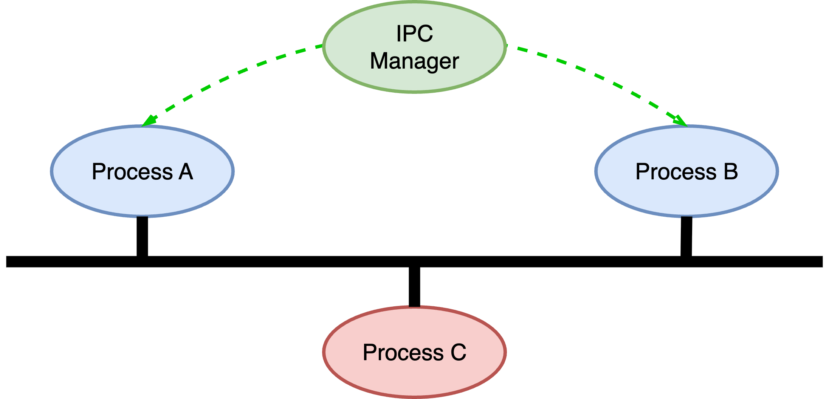
Trusted Channel
Notes:
Script:
So why do we care about trusted channels?
Earlier we talked about limited lifetimes, and we did it in the context of the analog to an attack surface where we have a window of opportunity where information is present, which we wish to keep secure.
If you have communication going on between process A and process B going through a system-mediated inter-process communications mechanism, you’re going directly into a trusted component that will only provide that data to the process that you've established.
However, we don't tend to work point-to-point.
We tend to use shared media.
That leaves us open to impact from other entities.
So, we go from just our process-to-process here in the abstract, to a situation where we've got process A and process B, and they're traversing a shared medium.
Whether this is Ethernet, CAN, LIN, or some wireless modality, isn’t relevant.
What is relevant is that there can be other entities, in this case a process C, sharing that medium.
Now ignoring the issue of contention on a shared medium, we have data that's going across it.
Unless we can trust the channel that we're pushing through this medium, then any information we transmit is susceptible to modification, capture, or interruption.
And so, what we want to do is establish mechanisms that are going to ensure none of these case occur.
We can do this a whole host of ways.
One is that we can just not send information between these two processes.
If you don't have to do something, then don’t.
It's that combination of lifetime and pressure.
Do we need to utilize this medium at all?
Are we pushing too much through the medium?
And are we ensuring that the data that we are pushing through the medium is done so in a secure fashion?
When we do have a genuine need to communicate securely then using secured channels eliminates the need to worry about outside interference.
As with standards-based cryptography, you should consult with your product cybersecurity SME to determine what means are available in order to ensure that you have trusted communication channels.

Slide 39
Enable Auditing
Notes:
Script:
Our next principal tends to sort of be an afterthought, and that's to enable auditing.
Let's talk about what it means to perform auditing in a cybersecurity context.

Slide 40
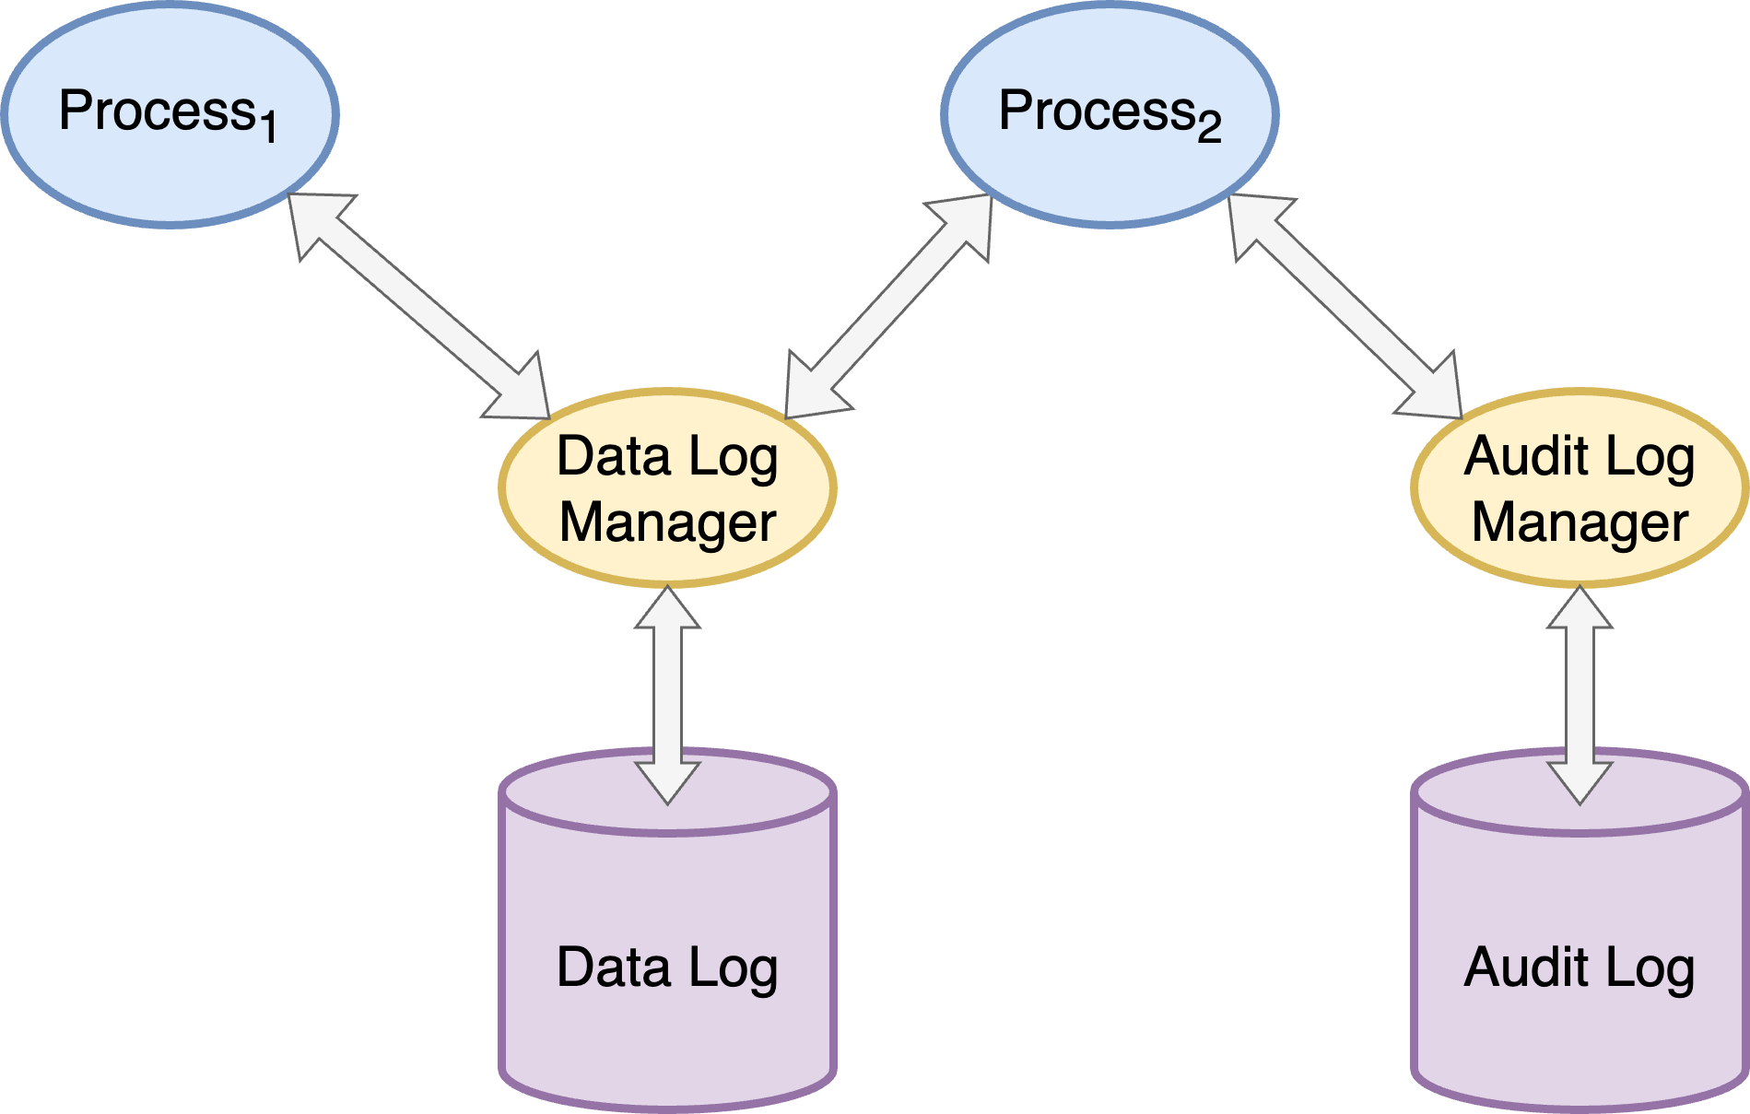
Data Log vs. Audit Log
Notes:
Script:
I'm sure that everyone is familiar with the concept of data logging where we collect information about the system as it's running so that we can later go back and extract various features to assist in the debugging and optimization processes.
Less considered is that in systems which are safety or operationally critical that it's important to have a separate logging mechanism that is performing an audit function capturing specific high-level events that occur in such a way that should an event arise which disturbs the system in a way that prevents it from being able to undertake its mission, that that information is recorded.
And more especially that it's recorded in a form which is not subject to tampering.
In the case of vehicles, or medical devices, or other systems of this nature we want to be able to extract this critical information as expeditiously as possible.
One reason to have a physically separate audit log is the security constraint of having a log which is immutable.
This would preclude using just a data log because of the computational burden of enforcing immutability.
Having that data be as small and as isolated as possible also reduces the likelihood that we won't be able to extract it should something physically happen to the storage itself.
Additionally, we need to consider that in a highly sophisticated system, there's a large amount of data going into the standard data log.
If something goes wrong, there's a high likelihood that the last several messages destined for the data log are lost due to buffering.
Whereas an audit log has such a low frequency that it is unlikely that you'll drop messages in a similar situation.

Slide 41
Degrade as Necessary
Notes:
Script:
This brings us to our last of the secure design principles and that's to degrade as necessary.
We talked about system pressure and how it can reach a maximum.
We didn't talk about what you do about that.
In any system that is safety or operationally critical, you should have designed in is the ability to do less in order to ensure that your primary operational goals are achieved in situations where system pressure reaches its maximum allowable limit.
Let's look a bit into that.

Slide 42
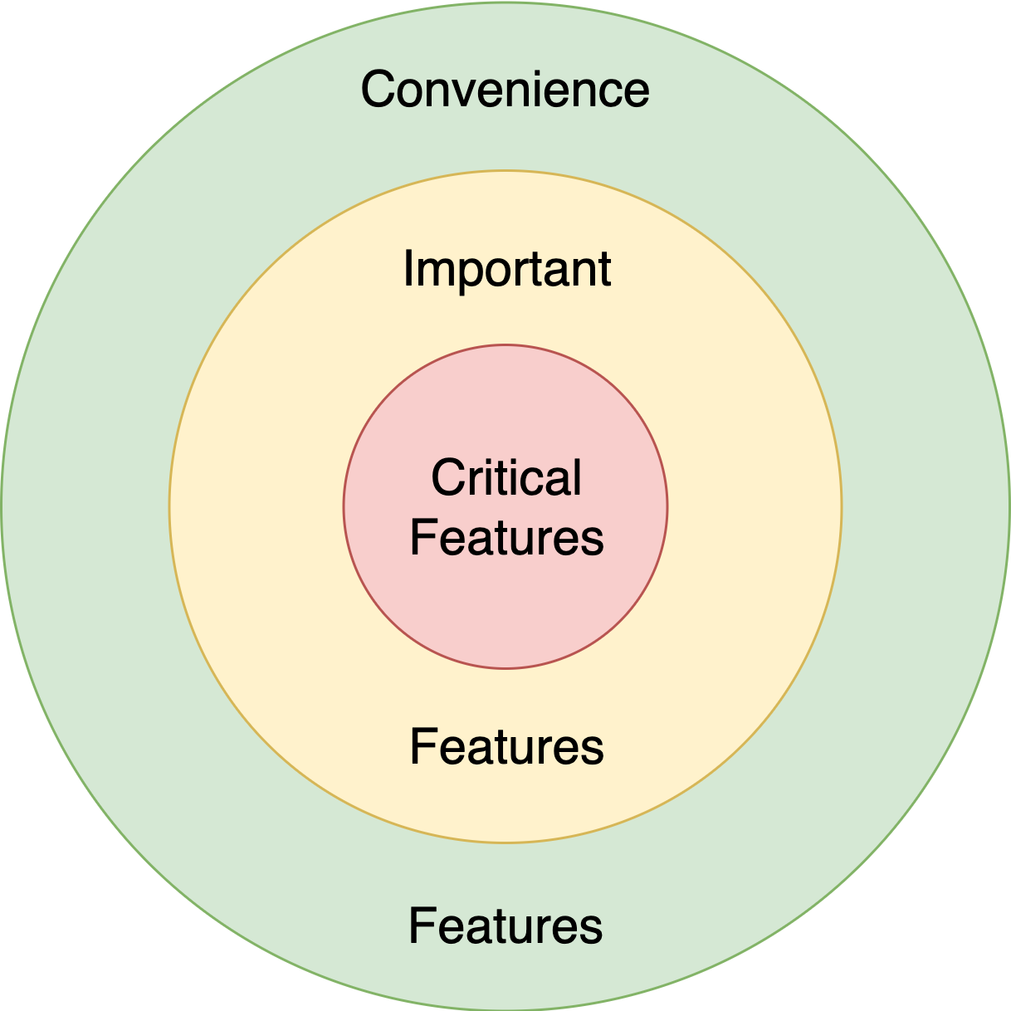
Prioritize Features
Notes:
Script:
In order to be able to degrade the system and still have it handle its core functions, you must first decide what is and is not important.
One could argue that everything is important.
Well, if everything is important, then technically nothing is important.
You start by identifying the critical elements.
Take your most safety or operationally critical elements and put them into a bucket, and those will be considered inviolate.
If you can’t perform those, then the system has failed.
The next set are important features.
These aren't at the same level as the critical features but are those which keep the system running smoothly.
Finally, are convenience features.
These are things which if we didn't have them the system would still function.
It might not be as elegant as one might like, but that's not the thing that we're considering here.
We're talking about those things which are not necessary to directly accomplish the goal.

Slide 43
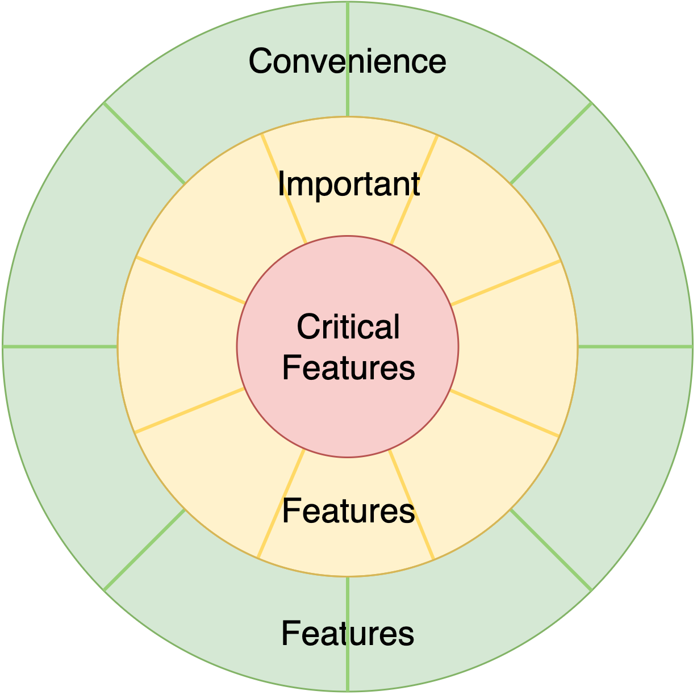
Feature-level Granularity
Notes:
Script:
So, we take those buckets and ensure that the features that we're talking about in both the important and convenience ones are quantized.
The coupling level needs to be sufficiently low so that we can turn off a feature or jettison it, as necessary.

Slide 44
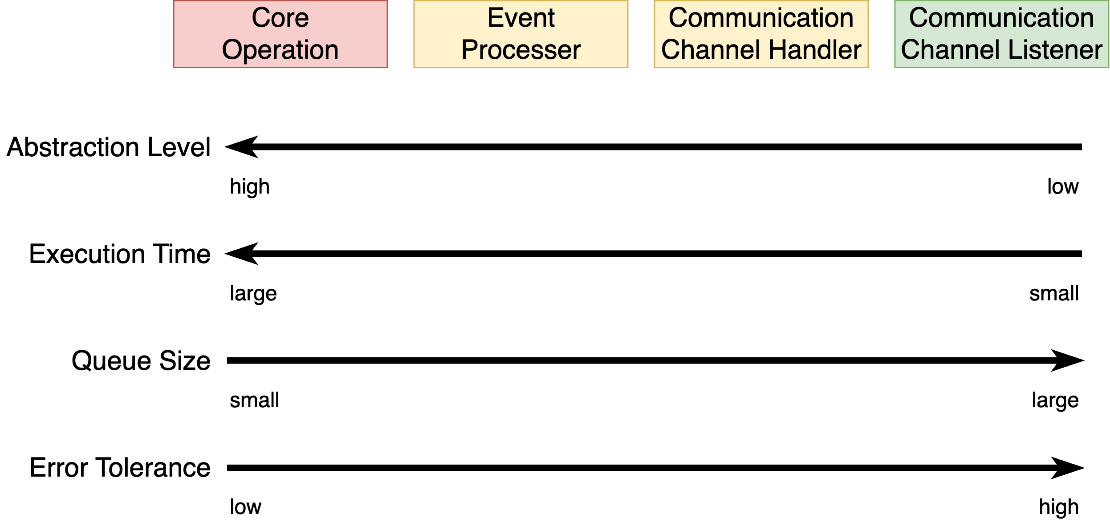
Degradation Example
Notes:
Script:
Let’s consider a real-world example and think about what it means in the context of needing to degrade.
If we have a communication stream that's coming into the system, then we could divide it as follows:
We have the core operation, which is our critical aspect.
We have an event processor, which is a high-level handler of events.
We have a communications channel handler, which is looking at specific channels that data is coming in over.
Both of these are in our important bucket.
And finally, we have the channel listener, which is sitting on this specific modality.
We put that in the convenience bucket.
Now this is not to say that if you can't get data from this, then that doesn't impact important stuff.
It's to say that this is a less important thing than the communications channel handler and the event processor.
Now, let's talk about why this particular arrangement has been chosen.
First, let's talk about abstraction level.
The channel listener receives incoming packets where the data is fragmented with no intrinsic meaning to the system itself.
These packets are handed off to the communications handler, which will then assemble a sequence of packets and form a cohesive message that is then handed to the event processor.
The event processor will then send an appropriate command to the core operation.
Each of these steps is increasing in abstraction level.
Similarly, when we think about this from the standpoint of execution.
At the communication listener, execution time is very rapid.
You're dealing with a small amount of data.
By the time we get to the core operation, the execution time is very large, because we're dealing with an abstract operation that we're attempting to engage in.
This is flipped when we look at the queue size.
The queue size for the communications channel listener tends to be large with respect to the size of the data itself.
By the time we get to the core operation, the queue size is much smaller because we can only handle so many events.
Similarly, at the communications channel we're expecting that there be a high tolerance to error.
Whereas in the core, we're expecting that the tolerance to error is much lower.
The coherence of the request needs to be high enough to ensure the request can be handled.
Because of all of this, if we end up with a situation where the channel listener is being flooded with noise for whatever reason, whether that's solar flares, or bad actors or whatever have you, we can take the active step of just stopping our active listening and periodically poll to see if the channel has quieted down.
One could argue that you don't want to lose data.
The problem is that you are trading off the ability to have the processing deal with the core versus having the processing being chewed up in the churn between the channel listener and the channel handler, which is trying to assemble this information and then pass it on down.
And so here we can see an example of where degrading is the correct way to approach this.
This requires that we build in mechanisms that allow us to recognize that we are overwhelming the system and that we can selectively disable and re-enable functionality selectively.
This mechanism of degrading and recovery is worthy of much discussion, but fundamentally it must be designed in. It can’t be easily retrofitted.

Slide 45
Summary
Notes:
Script:
That covers the secure design principles.
Let's take a step back and consider some of the takeaways.

Slide 46
Take Aways
Comprehensible
Aids downstream cybersecurity activities
Possible regulatory requirement
Layered analysis recommended
Notes:
Script:
The secure design principles are intended to be comprehensible.
There's nothing in them beyond the capabilities of systems and development teams to wrap their heads around, which is why it was presented in a hierarchical fashion.
These principles aid the downstream cybersecurity activities.
As we know, the further downstream you are when you need to impose a cybersecurity control that should have been supported earlier, the more costly that is in time and resources.
There's a possible regulatory element here that can never be overstated in a safety-critical domain.
Finally, it should be appreciated by this point that a layered analysis approach to design should be used.
This is not simply from a cybersecurity perspective, but from the functional and adjacent safety perspectives as well.

Slide 47
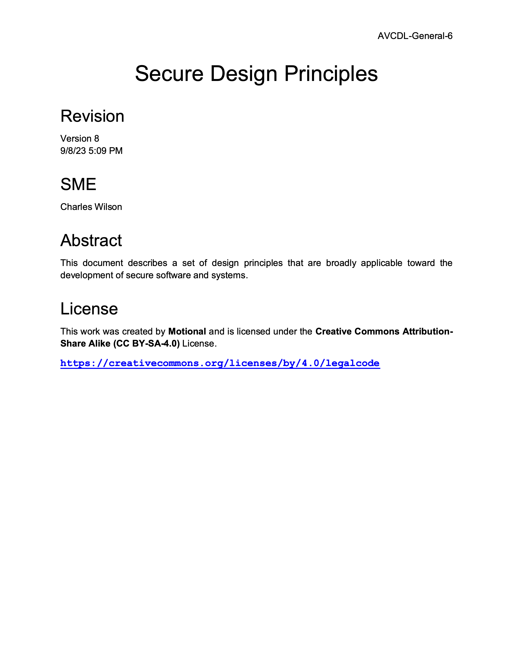
Further Reading
Notes:
Script:
For additional information and to get a more in-depth set of references, the Secure Design Principles secondary document is available in the AVCDL GitHub repository.

Slide 48
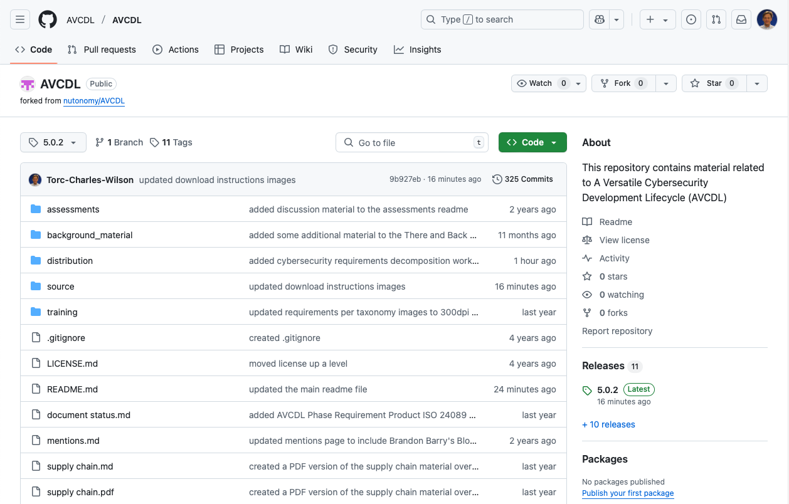
AVCDL on GitHub
https://github.com/AVCDL/AVCDL
Notes:
Script:
All AVCDL materials, both in source and distribution forms, are available on our GitHub site, as shown here.
Because of the size of the repository, it's recommended that you either clone the repository or download a ZIP archive of it, if you're not familiar with using git.
Instructions for downloading a ZIP archive are linked to on the repository’s front page.

Slide 49
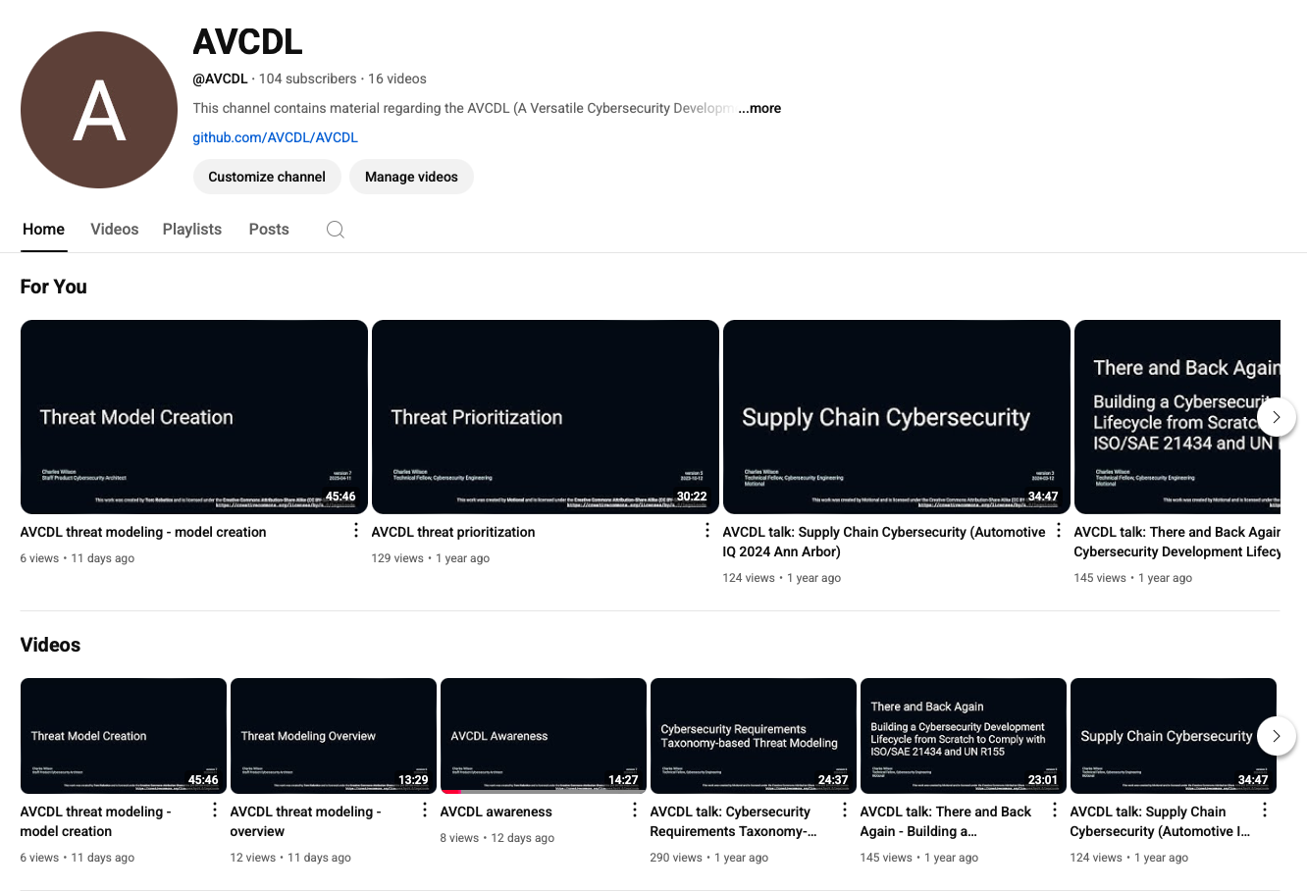
AVCDL on YouTube
https://youtube.com/@AVCDL
Notes:
Script:
Videos covering various aspects of the AVCDL are available on our YouTube channel, as shown here.
It's important to note that all AVCDL materials except for the introductory blog posts are intended for product cybersecurity engineering practitioners.

Slide 50
Next Steps
Notes:
Script:
With this training complete, you can proceed to one of the other trainings at this level.
These are:
Handling PII
Secure Deployment
Requirements Taxonomy
Threat Prioritization
and
Traceability
Additionally, you can also proceed to
Apply Secure Design

Slide 51
References (1 of 2)
AVCDL primary document
Secure Design Principles (AVCDL secondary document)
Attack Surface Analysis Report (AVCDL secondary document)
NIST SP 800-57 p1 r5 – Recommendation for Key Management: Part 1 – General
https://doi.org/10.6028/NIST.SP.800-57pt1r5
NIST SP 800-131A r3 d1 – Transitioning the Use of Cryptographic Algorithms and Key Lengths
https://doi.org/10.6028/NIST.SP.800-131Ar3.ipd
NIST SP 800-160 v1 – Engineering Trustworthy Secure Systems
https://nvlpubs.nist.gov/nistpubs/SpecialPublications/NIST.SP.800-160v1r1.pdf
Crypto Agility
https://csrc.nist.gov/projects/crypto-agility
Prohibiting RC4 Cipher Suites
https://datatracker.ietf.org/doc/rfc7465
Notes:
Script:
Here are references to the source material used in the creation of this presentation.
They'll also be included in the video description.
Additionally, this presentation’s source material will be provided on the AVCDL GitHub repository.

Slide 52
References (2 of 2)
The Protection of Information in Computer Systems
https://www.cs.virginia.edu/~evans/cs551/saltzer/
Industrial Cybersecurity - 2e (Ackerman)
https://www.amazon.com/dp/1800202091
Principled Assuredly Trustworthy Composable Architectures https://www.csl.sri.com/~neumann/chats4.pdf
Notes:
Script:

